Slide 1
Aula 06 – Redes Neurais Convolucionais
SIN 393 – Introdução à Visão Computacional (2023)
Prof. João Fernando Mari
joaofmari.github.io
joaof.mari@ufv.br

Slide 2
Roteiro
Pipelines de classificação
Perceptron de múltiplas camadas (MLP)
Redes Neurais Convolucionais (CNNs)
Camada convolucional
Camada de pooling
Função de ativação
Camada completamente conectada
Camada de saída – softmax
Função de perda (loss)
Otimizadores
Arquiteturas
Bibliotecas e desenvolvimento
Conjuntos de imagens

Slide 3
Pipelines de classificação
Pipeline clássico de classificação de imagens
Imagem
Extração de características
Classificador
MANUAL
TREINAVEL
Deep Learning
Imagem
Extração de características
(baixo-nível)
Extração de características
(médio-nível)
Extração de características
(alto-nível)
Classificador
TREINAVEL
TREINAVEL
TREINAVEL
TREINAVEL
Yann LeCun’s Deep Learning Course at CDS - SPRING 2021

Slide 4
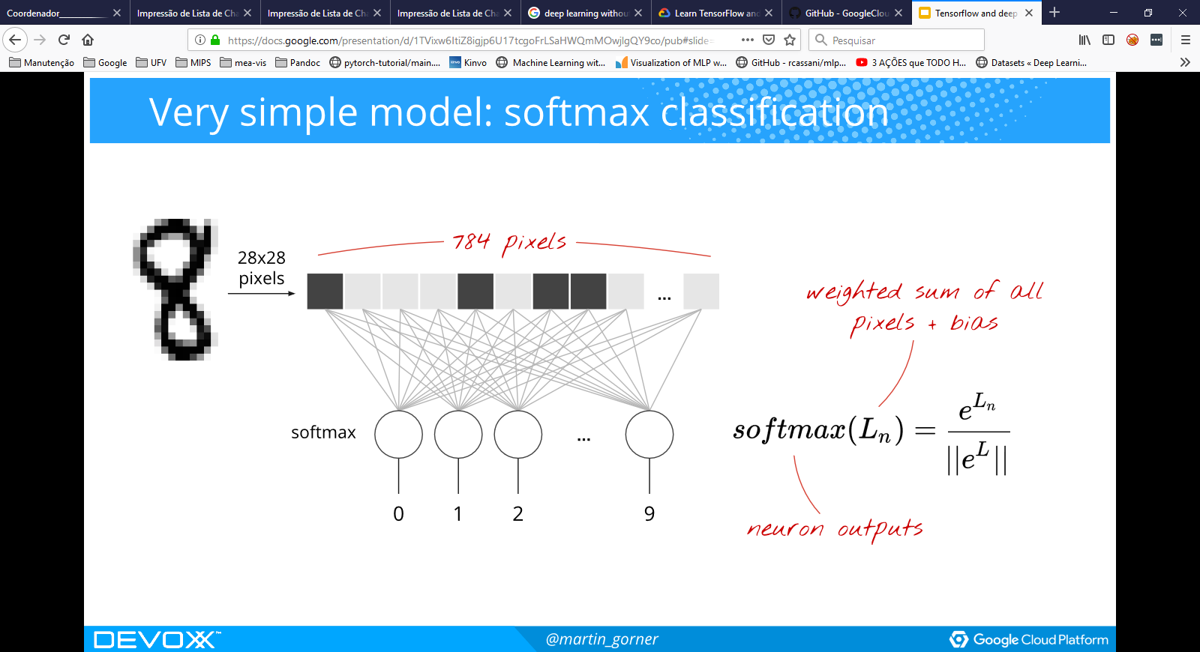
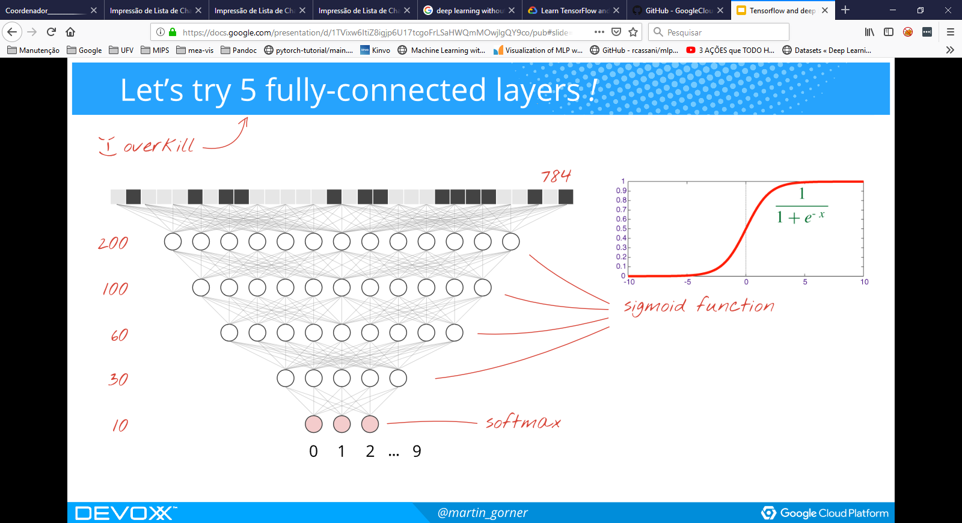
Perceptron de múltiplas camadas (MLP)
Learn TensorFlow and deep learning, without a Ph.D.

Slide 5
Redes Neurais Convolucionais (CNNs)
camada de entrada
camada convolucional
camada de pooling
camada convolucional
camada de pooling
camada completamente conectada
camada softmax
p filtros
q filtros
Classe 1
Classe 2
Classe 3
Classe 4
q canais
Classe 5
p canais
q canais
p canais
Aprendizagem de características
Classificação

Slide 6
Camada convolucional

Slide 7
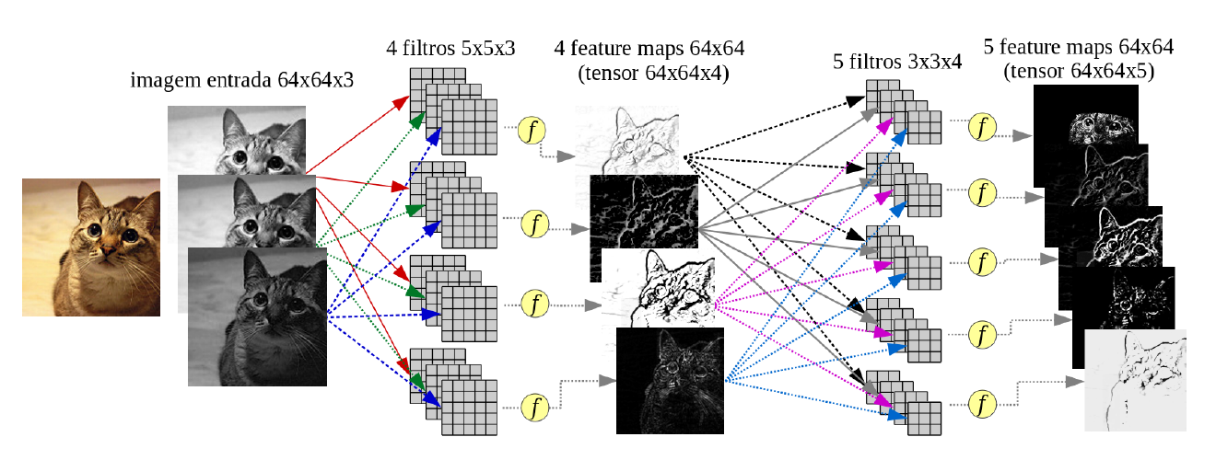
Camada convolucional
Moacir Ponti. http://conteudo.icmc.usp.br/pessoas/moacir/p17sibgrapi-tutorial/

Slide 8
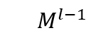
Camada convolucional
$$M_{}^{l−1}$$
...
D canais

Slide 9
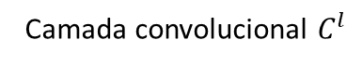
Camada convolucional
Camada convolucional $C_{}^{l}$
$$M_{}^{l−1}$$
k=1
...

Slide 10
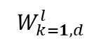
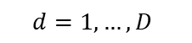
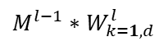
Camada convolucional
Camada convolucional $C_{}^{l}$
$$W_{k=1, d}^{l}$$
$$M_{}^{l−1}$$
k=1
D canais
...
$${M^{l−1}∗W}_{k=1,d}^{l}$$
$$d=1, …,D$$
D canais

Slide 11
Camada convolucional
Camada convolucional $C_{}^{l}$
*
$$W_{k=1, d}^{l}$$
$$M_{}^{l−1}$$
k=1
...
$${M^{l−1}∗W}_{k=1,d}^{l}$$
...
$$d=1, …,D$$

Slide 12
Camada convolucional
Camada convolucional $C_{}^{l}$
*
*
$$W_{k=1, d}^{l}$$
$$M_{}^{l−1}$$
k=1
...
$${M^{l−1}∗W}_{k=1,d}^{l}$$
$$d=1, …,D$$

Slide 13
Camada convolucional
Camada convolucional $C_{}^{l}$
*
*
...
*
$$W_{k=1, d}^{l}$$
...
$$M_{}^{l−1}$$
k=1
...
$${M^{l−1}∗W}_{k=1,d}^{l}$$
...
$$d=1, …,D$$

Slide 14
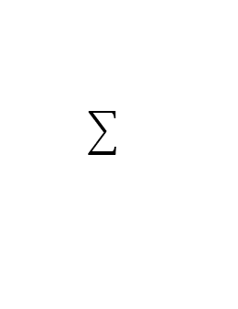
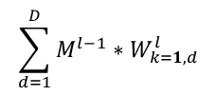
Camada convolucional
Camada convolucional $C_{}^{l}$
*
*
...
*
$$W_{k=1, d}^{l}$$
...
$$\sum_{d=1}^{D}{{M^{l−1}∗W}_{k=1,d}^{l}}$$
$$M_{}^{l−1}$$
k=1
...
$${M^{l−1}∗W}_{k=1,d}^{l}$$
...
$$d=1, …,D$$

Slide 15
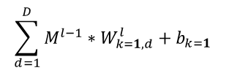
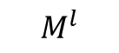
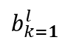
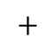
Camada convolucional
Camada convolucional $C_{}^{l}$
*
$$\sum_{d=1}^{D}{{M^{l−1}∗W}_{k=1,d}^{l}}+b_{k=1}$$
*
...
*
$$W_{k=1, d}^{l}$$
...
$$\sum_{d=1}^{D}{{M^{l−1}∗W}_{k=1,d}^{l}}$$
$$M_{}^{l−1}$$
k=1
$b_{k=1}^{l}$
...
$$+$$
$${M^{l−1}∗W}_{k=1,d}^{l}$$
...
$$d=1, …,D$$
$$M_{}^{l}$$
...

Slide 16
Camada convolucional
Camada convolucional $C_{}^{l}$
*
$$\sum_{d=1}^{D}{{M^{l−1}∗W}_{k=1,d}^{l}}+b_{k=1}$$
*
...
*
$$W_{k=1, d}^{l}$$
...
$$\sum_{d=1}^{D}{{M^{l−1}∗W}_{k=1,d}^{l}}$$
$$M_{}^{l−1}$$
k=1
$b_{k=1}^{l}$
...
$$+$$
ReLu
$${M^{l−1}∗W}_{k=1,d}^{l}$$
...
$$d=1, …,D$$
$$M_{}^{l}$$
...

Slide 17
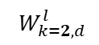
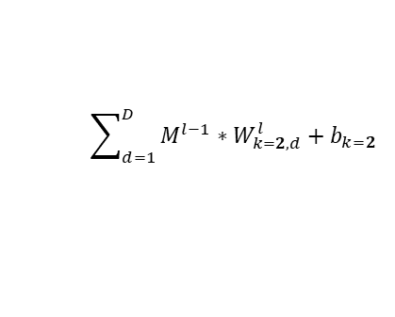
Camada convolucional
Camada convolucional $C_{}^{l}$
*
$$\sum_{d=1}^{D}{{M^{l−1}∗W}_{k=1,d}^{l}}+b_{k=1}$$
*
...
*
$$W_{k=1, d}^{l}$$
...
$$\sum_{d=1}^{D}{{M^{l−1}∗W}_{k=1,d}^{l}}$$
$$M_{}^{l−1}$$
k=1
$b_{k=1}^{l}$
...
$$+$$
ReLu
$${M^{l−1}∗W}_{k=1,d}^{l}$$
...
$$d=1, …,D$$
k=2
$$W_{k=2, d}^{l}$$
$$\sum_{d=1}^{D}{{M^{l−1}∗W}_{k=2,d}^{l}}+b_{k=2}$$
$$M_{}^{l}$$
...
...

Slide 18
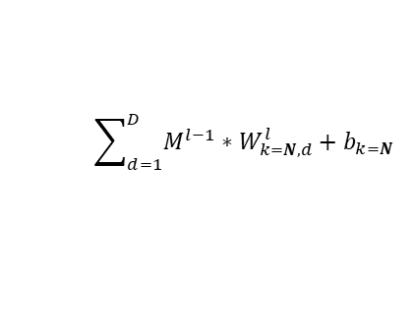
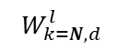
Camada convolucional
Camada convolucional $C_{}^{l}$
*
$$\sum_{d=1}^{D}{{M^{l−1}∗W}_{k=1,d}^{l}}+b_{k=1}$$
*
...
*
$$W_{k=1, d}^{l}$$
...
$$\sum_{d=1}^{D}{{M^{l−1}∗W}_{k=1,d}^{l}}$$
$$M_{}^{l−1}$$
k=1
$b_{k=1}^{l}$
...
$$+$$
ReLu
$${M^{l−1}∗W}_{k=1,d}^{l}$$
...
$$d=1, …,D$$
k=2
$$W_{k=2, d}^{l}$$
$$\sum_{d=1}^{D}{{M^{l−1}∗W}_{k=2,d}^{l}}+b_{k=2}$$
$$M_{}^{l}$$
...
...
...
...
k=N
$$W_{k=N, d}^{l}$$
$$\sum_{d=1}^{D}{{M^{l−1}∗W}_{k=N,d}^{l}}+b_{k=N}$$
...
N canais

Slide 19
Camada convolucional
x[:,:,0] 5×5 + pad 1
w0[:,:,0]
x[:,:,0] * w0[:,:,0]
0 | 0 | 0 | 0 | 0 | 0 | 0
0 | 6 | 3 | 4 | 6 | 2 | 0
0 | 7 | 4 | 4 | 6 | 1 | 0
0 | 2 | 6 | 2 | 2 | 7 | 0
0 | 4 | 3 | 7 | 7 | 2 | 0
0 | 5 | 4 | 1 | 7 | 3 | 0
0 | 0 | 0 | 0 | 0 | 0 | 0
-1 | 1 | 1
1 | 1 | 2
0 | -2 | 1
x[:,:,1] * w0[:,:,1]
b0
w0[:,:,1]
1
-1 | 1 | -1
-1 | 1 | 2
-1 | -1 | 1
x[:,:,2] * w0[:,:,2]
x[:,:,1] 5×5 + pad 1
w0[:,:,2]
0 | 0 | 0 | 0 | 0 | 0 | 0
0 | 5 | 5 | 1 | 7 | 3 | 0
0 | 4 | 0 | 3 | 1 | 5 | 0
0 | 4 | 3 | 0 | 0 | 2 | 0
0 | 2 | 6 | 1 | 7 | 3 | 0
0 | 3 | 7 | 6 | 5 | 5 | 0
0 | 0 | 0 | 0 | 0 | 0 | 0
-1 | -1 | 1
1 | -2 | 2
2 | -1 | 2
w1[:,:,0]
x[:,:,0] * w1[:,:,0]
-1 | -2 | 1
1 | 1 | 2
-2 | 2 | 2
x[:,:,1] * w1[:,:,1]
b1
x[:,:,2] 5×5 + pad 1
w1[:,:,1]
0
0 | 0 | 0 | 0 | 0 | 0 | 0
0 | 6 | 5 | 2 | 3 | 6 | 0
0 | 3 | 7 | 0 | 2 | 4 | 0
0 | 2 | 6 | 4 | 0 | 6 | 0
0 | 1 | 3 | 0 | 3 | 5 | 0
0 | 1 | 1 | 0 | 1 | 4 | 0
0 | 0 | 0 | 0 | 0 | 0 | 0
-2 | -2 | -2
-2 | 1 | 0
0 | -2 | 0
x[:,:,2] * w1[:,:,2]
w1[:,:,2]
0 | -2 | 0
2 | -1 | -1
-2 | 1 | -2
https://cs231n.github.io/convolutional-networks/

Slide 20
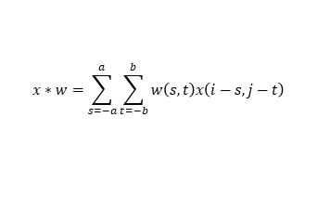
Camada convolucional
x[:,:,0] 5×5 + pad 1
w0[:,:,0]
x[:,:,0] * w0[:,:,0]
0 | 0 | 0 | 0 | 0 | 0 | 0
0 | 6 | 3 | 4 | 6 | 2 | 0
0 | 7 | 4 | 4 | 6 | 1 | 0
0 | 2 | 6 | 2 | 2 | 7 | 0
0 | 4 | 3 | 7 | 7 | 2 | 0
0 | 5 | 4 | 1 | 7 | 3 | 0
0 | 0 | 0 | 0 | 0 | 0 | 0
-1 | 1 | 1
1 | 1 | 2
0 | -2 | 1
*
x[:,:,1] * w0[:,:,1]
b0
w0[:,:,1]
1
-1 | 1 | -1
-1 | 1 | 2
-1 | -1 | 1
$$x∗w=\sum_{s=−a}^{a}{\sum_{t=−b}^{b}{w\left(s,t\right)x\left(i−s,j−t\right)}}$$
*
x[:,:,2] * w0[:,:,2]
x[:,:,1] 5×5 + pad 1
w0[:,:,2]
0 | 0 | 0 | 0 | 0 | 0 | 0
0 | 5 | 5 | 1 | 7 | 3 | 0
0 | 4 | 0 | 3 | 1 | 5 | 0
0 | 4 | 3 | 0 | 0 | 2 | 0
0 | 2 | 6 | 1 | 7 | 3 | 0
0 | 3 | 7 | 6 | 5 | 5 | 0
0 | 0 | 0 | 0 | 0 | 0 | 0
-1 | -1 | 1
1 | -2 | 2
2 | -1 | 2
*
w1[:,:,0]
x[:,:,0] * w1[:,:,0]
-1 | -2 | 1
1 | 1 | 2
-2 | 2 | 2
*
x[:,:,1] * w1[:,:,1]
b1
x[:,:,2] 5×5 + pad 1
w1[:,:,1]
0
0 | 0 | 0 | 0 | 0 | 0 | 0
0 | 6 | 5 | 2 | 3 | 6 | 0
0 | 3 | 7 | 0 | 2 | 4 | 0
0 | 2 | 6 | 4 | 0 | 6 | 0
0 | 1 | 3 | 0 | 3 | 5 | 0
0 | 1 | 1 | 0 | 1 | 4 | 0
0 | 0 | 0 | 0 | 0 | 0 | 0
-2 | -2 | -2
-2 | 1 | 0
0 | -2 | 0
x[:,:,2] * w1[:,:,2]
*
w1[:,:,2]
0 | -2 | 0
2 | -1 | -1
-2 | 1 | -2
*

Slide 21
Camada convolucional
x[:,:,0] 5×5 + pad 1
w0[:,:,0]
x[:,:,0] * w0[:,:,0]
0 | 0 | 0 | 0 | 0 | 0 | 0
0 | 6 | 3 | 4 | 6 | 2 | 0
0 | 7 | 4 | 4 | 6 | 1 | 0
0 | 2 | 6 | 2 | 2 | 7 | 0
0 | 4 | 3 | 7 | 7 | 2 | 0
0 | 5 | 4 | 1 | 7 | 3 | 0
0 | 0 | 0 | 0 | 0 | 0 | 0
-1 | 1 | 1
1 | 1 | 2
0 | -2 | 1
x[:,:,1] * w0[:,:,1]
b0
w0[:,:,1]
1
-1 | 1 | -1
-1 | 1 | 2
-1 | -1 | 1
x[:,:,2] * w0[:,:,2]
x[:,:,1] 5×5 + pad 1
w0[:,:,2]
0 | 0 | 0 | 0 | 0 | 0 | 0
0 | 5 | 5 | 1 | 7 | 3 | 0
0 | 4 | 0 | 3 | 1 | 5 | 0
0 | 4 | 3 | 0 | 0 | 2 | 0
0 | 2 | 6 | 1 | 7 | 3 | 0
0 | 3 | 7 | 6 | 5 | 5 | 0
0 | 0 | 0 | 0 | 0 | 0 | 0
-1 | -1 | 1
1 | -2 | 2
2 | -1 | 2
w1[:,:,0]
x[:,:,0] * w1[:,:,0]
-1 | -2 | 1
1 | 1 | 2
-2 | 2 | 2
x[:,:,1] * w1[:,:,1]
b1
x[:,:,2] 5×5 + pad 1
w1[:,:,1]
0
0 | 0 | 0 | 0 | 0 | 0 | 0
0 | 6 | 5 | 2 | 3 | 6 | 0
0 | 3 | 7 | 0 | 2 | 4 | 0
0 | 2 | 6 | 4 | 0 | 6 | 0
0 | 1 | 3 | 0 | 3 | 5 | 0
0 | 1 | 1 | 0 | 1 | 4 | 0
0 | 0 | 0 | 0 | 0 | 0 | 0
-2 | -2 | -2
-2 | 1 | 0
0 | -2 | 0
x[:,:,2] * w1[:,:,2]
w1[:,:,2]
0 | -2 | 0
2 | -1 | -1
-2 | 1 | -2

Slide 22
Camada convolucional
x[:,:,0] 5×5 + pad 1
w0[:,:,0]
x[:,:,0] * w0[:,:,0]
0 | 0 | 0 | 0 | 0 | 0 | 0
0 | 6 | 3 | 4 | 6 | 2 | 0
0 | 7 | 4 | 4 | 6 | 1 | 0
0 | 2 | 6 | 2 | 2 | 7 | 0
0 | 4 | 3 | 7 | 7 | 2 | 0
0 | 5 | 4 | 1 | 7 | 3 | 0
0 | 0 | 0 | 0 | 0 | 0 | 0
-1 | 1 | 1
1 | 1 | 2
0 | -2 | 1
12
x[:,:,1] * w0[:,:,1]
b0
w0[:,:,1]
4
1
-1 | 1 | -1
-1 | 1 | 2
-1 | -1 | 1
x[:,:,2] * w0[:,:,2]
-17
x[:,:,1] 5×5 + pad 1
w0[:,:,2]
0 | 0 | 0 | 0 | 0 | 0 | 0
0 | 5 | 5 | 1 | 7 | 3 | 0
0 | 4 | 0 | 3 | 1 | 5 | 0
0 | 4 | 3 | 0 | 0 | 2 | 0
0 | 2 | 6 | 1 | 7 | 3 | 0
0 | 3 | 7 | 6 | 5 | 5 | 0
0 | 0 | 0 | 0 | 0 | 0 | 0
-1 | -1 | 1
1 | -2 | 2
2 | -1 | 2
w1[:,:,0]
x[:,:,0] * w1[:,:,0]
-1 | -2 | 1
1 | 1 | 2
-2 | 2 | 2
-9
x[:,:,1] * w1[:,:,1]
b1
x[:,:,2] 5×5 + pad 1
w1[:,:,1]
-13
0
0 | 0 | 0 | 0 | 0 | 0 | 0
0 | 6 | 5 | 2 | 3 | 6 | 0
0 | 3 | 7 | 0 | 2 | 4 | 0
0 | 2 | 6 | 4 | 0 | 6 | 0
0 | 1 | 3 | 0 | 3 | 5 | 0
0 | 1 | 1 | 0 | 1 | 4 | 0
0 | 0 | 0 | 0 | 0 | 0 | 0
-2 | -2 | -2
-2 | 1 | 0
0 | -2 | 0
x[:,:,2] * w1[:,:,2]
-2
w1[:,:,2]
0 | -2 | 0
2 | -1 | -1
-2 | 1 | -2

Slide 23
Camada convolucional
x[:,:,0] 5×5 + pad 1
w0[:,:,0]
x[:,:,0] * w0[:,:,0]
0 | 0 | 0 | 0 | 0 | 0 | 0
0 | 6 | 3 | 4 | 6 | 2 | 0
0 | 7 | 4 | 4 | 6 | 1 | 0
0 | 2 | 6 | 2 | 2 | 7 | 0
0 | 4 | 3 | 7 | 7 | 2 | 0
0 | 5 | 4 | 1 | 7 | 3 | 0
0 | 0 | 0 | 0 | 0 | 0 | 0
-1 | 1 | 1
1 | 1 | 2
0 | -2 | 1
12 | 26
x[:,:,1] * w0[:,:,1]
b0
w0[:,:,1]
4 | 7
1
-1 | 1 | -1
-1 | 1 | 2
-1 | -1 | 1
x[:,:,2] * w0[:,:,2]
-17 | 0
x[:,:,1] 5×5 + pad 1
w0[:,:,2]
0 | 0 | 0 | 0 | 0 | 0 | 0
0 | 5 | 5 | 1 | 7 | 3 | 0
0 | 4 | 0 | 3 | 1 | 5 | 0
0 | 4 | 3 | 0 | 0 | 2 | 0
0 | 2 | 6 | 1 | 7 | 3 | 0
0 | 3 | 7 | 6 | 5 | 5 | 0
0 | 0 | 0 | 0 | 0 | 0 | 0
-1 | -1 | 1
1 | -2 | 2
2 | -1 | 2
w1[:,:,0]
x[:,:,0] * w1[:,:,0]
-1 | -2 | 1
1 | 1 | 2
-2 | 2 | 2
-9 | 14
x[:,:,1] * w1[:,:,1]
b1
x[:,:,2] 5×5 + pad 1
w1[:,:,1]
-13 | -11
0
0 | 0 | 0 | 0 | 0 | 0 | 0
0 | 6 | 5 | 2 | 3 | 6 | 0
0 | 3 | 7 | 0 | 2 | 4 | 0
0 | 2 | 6 | 4 | 0 | 6 | 0
0 | 1 | 3 | 0 | 3 | 5 | 0
0 | 1 | 1 | 0 | 1 | 4 | 0
0 | 0 | 0 | 0 | 0 | 0 | 0
-2 | -2 | -2
-2 | 1 | 0
0 | -2 | 0
x[:,:,2] * w1[:,:,2]
-2 | -21
w1[:,:,2]
0 | -2 | 0
2 | -1 | -1
-2 | 1 | -2

Slide 24
Camada convolucional
x[:,:,0] 5×5 + pad 1
w0[:,:,0]
x[:,:,0] * w0[:,:,0]
0 | 0 | 0 | 0 | 0 | 0 | 0
0 | 6 | 3 | 4 | 6 | 2 | 0
0 | 7 | 4 | 4 | 6 | 1 | 0
0 | 2 | 6 | 2 | 2 | 7 | 0
0 | 4 | 3 | 7 | 7 | 2 | 0
0 | 5 | 4 | 1 | 7 | 3 | 0
0 | 0 | 0 | 0 | 0 | 0 | 0
-1 | 1 | 1
1 | 1 | 2
0 | -2 | 1
12 | 26 | 18
x[:,:,1] * w0[:,:,1]
b0
w0[:,:,1]
4 | 7 | 6
1
-1 | 1 | -1
-1 | 1 | 2
-1 | -1 | 1
x[:,:,2] * w0[:,:,2]
-17 | 0 | 14
x[:,:,1] 5×5 + pad 1
w0[:,:,2]
0 | 0 | 0 | 0 | 0 | 0 | 0
0 | 5 | 5 | 1 | 7 | 3 | 0
0 | 4 | 0 | 3 | 1 | 5 | 0
0 | 4 | 3 | 0 | 0 | 2 | 0
0 | 2 | 6 | 1 | 7 | 3 | 0
0 | 3 | 7 | 6 | 5 | 5 | 0
0 | 0 | 0 | 0 | 0 | 0 | 0
-1 | -1 | 1
1 | -2 | 2
2 | -1 | 2
w1[:,:,0]
x[:,:,0] * w1[:,:,0]
-1 | -2 | 1
1 | 1 | 2
-2 | 2 | 2
-9 | 14 | 6
x[:,:,1] * w1[:,:,1]
b1
x[:,:,2] 5×5 + pad 1
w1[:,:,1]
-13 | -11 | -21
0
0 | 0 | 0 | 0 | 0 | 0 | 0
0 | 6 | 5 | 2 | 3 | 6 | 0
0 | 3 | 7 | 0 | 2 | 4 | 0
0 | 2 | 6 | 4 | 0 | 6 | 0
0 | 1 | 3 | 0 | 3 | 5 | 0
0 | 1 | 1 | 0 | 1 | 4 | 0
0 | 0 | 0 | 0 | 0 | 0 | 0
-2 | -2 | -2
-2 | 1 | 0
0 | -2 | 0
x[:,:,2] * w1[:,:,2]
-2 | -21 | -1
w1[:,:,2]
0 | -2 | 0
2 | -1 | -1
-2 | 1 | -2

Slide 25
Camada convolucional
x[:,:,0] 5×5 + pad 1
w0[:,:,0]
x[:,:,0] * w0[:,:,0]
0 | 0 | 0 | 0 | 0 | 0 | 0
0 | 6 | 3 | 4 | 6 | 2 | 0
0 | 7 | 4 | 4 | 6 | 1 | 0
0 | 2 | 6 | 2 | 2 | 7 | 0
0 | 4 | 3 | 7 | 7 | 2 | 0
0 | 5 | 4 | 1 | 7 | 3 | 0
0 | 0 | 0 | 0 | 0 | 0 | 0
-1 | 1 | 1
1 | 1 | 2
0 | -2 | 1
12 | 26 | 18 | 25
x[:,:,1] * w0[:,:,1]
b0
w0[:,:,1]
4 | 7 | 6 | -1
1
-1 | 1 | -1
-1 | 1 | 2
-1 | -1 | 1
x[:,:,2] * w0[:,:,2]
-17 | 0 | 14 | -2
x[:,:,1] 5×5 + pad 1
w0[:,:,2]
0 | 0 | 0 | 0 | 0 | 0 | 0
0 | 5 | 5 | 1 | 7 | 3 | 0
0 | 4 | 0 | 3 | 1 | 5 | 0
0 | 4 | 3 | 0 | 0 | 2 | 0
0 | 2 | 6 | 1 | 7 | 3 | 0
0 | 3 | 7 | 6 | 5 | 5 | 0
0 | 0 | 0 | 0 | 0 | 0 | 0
-1 | -1 | 1
1 | -2 | 2
2 | -1 | 2
w1[:,:,0]
x[:,:,0] * w1[:,:,0]
-1 | -2 | 1
1 | 1 | 2
-2 | 2 | 2
-9 | 14 | 6 | 7
x[:,:,1] * w1[:,:,1]
b1
x[:,:,2] 5×5 + pad 1
w1[:,:,1]
-13 | -11 | -21 | -17
0
0 | 0 | 0 | 0 | 0 | 0 | 0
0 | 6 | 5 | 2 | 3 | 6 | 0
0 | 3 | 7 | 0 | 2 | 4 | 0
0 | 2 | 6 | 4 | 0 | 6 | 0
0 | 1 | 3 | 0 | 3 | 5 | 0
0 | 1 | 1 | 0 | 1 | 4 | 0
0 | 0 | 0 | 0 | 0 | 0 | 0
-2 | -2 | -2
-2 | 1 | 0
0 | -2 | 0
x[:,:,2] * w1[:,:,2]
-2 | -21 | -1 | 3
w1[:,:,2]
0 | -2 | 0
2 | -1 | -1
-2 | 1 | -2

Slide 26
Camada convolucional
x[:,:,0] 5×5 + pad 1
w0[:,:,0]
x[:,:,0] * w0[:,:,0]
0 | 0 | 0 | 0 | 0 | 0 | 0
0 | 6 | 3 | 4 | 6 | 2 | 0
0 | 7 | 4 | 4 | 6 | 1 | 0
0 | 2 | 6 | 2 | 2 | 7 | 0
0 | 4 | 3 | 7 | 7 | 2 | 0
0 | 5 | 4 | 1 | 7 | 3 | 0
0 | 0 | 0 | 0 | 0 | 0 | 0
-1 | 1 | 1
1 | 1 | 2
0 | -2 | 1
12 | 26 | 18 | 25 | 21
x[:,:,1] * w0[:,:,1]
b0
w0[:,:,1]
4 | 7 | 6 | -1 | 12
1
-1 | 1 | -1
-1 | 1 | 2
-1 | -1 | 1
x[:,:,2] * w0[:,:,2]
-17 | 0 | 14 | -2 | -8
x[:,:,1] 5×5 + pad 1
w0[:,:,2]
0 | 0 | 0 | 0 | 0 | 0 | 0
0 | 5 | 5 | 1 | 7 | 3 | 0
0 | 4 | 0 | 3 | 1 | 5 | 0
0 | 4 | 3 | 0 | 0 | 2 | 0
0 | 2 | 6 | 1 | 7 | 3 | 0
0 | 3 | 7 | 6 | 5 | 5 | 0
0 | 0 | 0 | 0 | 0 | 0 | 0
-1 | -1 | 1
1 | -2 | 2
2 | -1 | 2
w1[:,:,0]
x[:,:,0] * w1[:,:,0]
-1 | -2 | 1
1 | 1 | 2
-2 | 2 | 2
-9 | 14 | 6 | 7 | 18
x[:,:,1] * w1[:,:,1]
b1
x[:,:,2] 5×5 + pad 1
w1[:,:,1]
-13 | -11 | -21 | -17 | -9
0
0 | 0 | 0 | 0 | 0 | 0 | 0
0 | 6 | 5 | 2 | 3 | 6 | 0
0 | 3 | 7 | 0 | 2 | 4 | 0
0 | 2 | 6 | 4 | 0 | 6 | 0
0 | 1 | 3 | 0 | 3 | 5 | 0
0 | 1 | 1 | 0 | 1 | 4 | 0
0 | 0 | 0 | 0 | 0 | 0 | 0
-2 | -2 | -2
-2 | 1 | 0
0 | -2 | 0
x[:,:,2] * w1[:,:,2]
-2 | -21 | -1 | 3 | -17
w1[:,:,2]
0 | -2 | 0
2 | -1 | -1
-2 | 1 | -2

Slide 27
Camada convolucional
x[:,:,0] 5×5 + pad 1
w0[:,:,0]
x[:,:,0] * w0[:,:,0]
0 | 0 | 0 | 0 | 0 | 0 | 0
0 | 6 | 3 | 4 | 6 | 2 | 0
0 | 7 | 4 | 4 | 6 | 1 | 0
0 | 2 | 6 | 2 | 2 | 7 | 0
0 | 4 | 3 | 7 | 7 | 2 | 0
0 | 5 | 4 | 1 | 7 | 3 | 0
0 | 0 | 0 | 0 | 0 | 0 | 0
-1 | 1 | 1
1 | 1 | 2
0 | -2 | 1
12 | 26 | 18 | 25 | 21
-5
x[:,:,1] * w0[:,:,1]
b0
w0[:,:,1]
4 | 7 | 6 | -1 | 12
-5
1
-1 | 1 | -1
-1 | 1 | 2
-1 | -1 | 1
x[:,:,2] * w0[:,:,2]
-17 | 0 | 14 | -2 | -8
-3
x[:,:,1] 5×5 + pad 1
w0[:,:,2]
0 | 0 | 0 | 0 | 0 | 0 | 0
0 | 5 | 5 | 1 | 7 | 3 | 0
0 | 4 | 0 | 3 | 1 | 5 | 0
0 | 4 | 3 | 0 | 0 | 2 | 0
0 | 2 | 6 | 1 | 7 | 3 | 0
0 | 3 | 7 | 6 | 5 | 5 | 0
0 | 0 | 0 | 0 | 0 | 0 | 0
-1 | -1 | 1
1 | -2 | 2
2 | -1 | 2
w1[:,:,0]
x[:,:,0] * w1[:,:,0]
-1 | -2 | 1
1 | 1 | 2
-2 | 2 | 2
-9 | 14 | 6 | 7 | 18
7
x[:,:,1] * w1[:,:,1]
b1
x[:,:,2] 5×5 + pad 1
w1[:,:,1]
-13 | -11 | -21 | -17 | -9
-20
0
0 | 0 | 0 | 0 | 0 | 0 | 0
0 | 6 | 5 | 2 | 3 | 6 | 0
0 | 3 | 7 | 0 | 2 | 4 | 0
0 | 2 | 6 | 4 | 0 | 6 | 0
0 | 1 | 3 | 0 | 3 | 5 | 0
0 | 1 | 1 | 0 | 1 | 4 | 0
0 | 0 | 0 | 0 | 0 | 0 | 0
-2 | -2 | -2
-2 | 1 | 0
0 | -2 | 0
x[:,:,2] * w1[:,:,2]
-2 | -21 | -1 | 3 | -17
3
w1[:,:,2]
0 | -2 | 0
2 | -1 | -1
-2 | 1 | -2

Slide 28
Camada convolucional
x[:,:,0] 5×5 + pad 1
w0[:,:,0]
x[:,:,0] * w0[:,:,0]
0 | 0 | 0 | 0 | 0 | 0 | 0
0 | 6 | 3 | 4 | 6 | 2 | 0
0 | 7 | 4 | 4 | 6 | 1 | 0
0 | 2 | 6 | 2 | 2 | 7 | 0
0 | 4 | 3 | 7 | 7 | 2 | 0
0 | 5 | 4 | 1 | 7 | 3 | 0
0 | 0 | 0 | 0 | 0 | 0 | 0
-1 | 1 | 1
1 | 1 | 2
0 | -2 | 1
12 | 26 | 18 | 25 | 21
12
x[:,:,1] * w0[:,:,1]
b0
w0[:,:,1]
4 | 7 | 6 | -1 | 12
4
1
-1 | 1 | -1
-1 | 1 | 2
-1 | -1 | 1
x[:,:,2] * w0[:,:,2]
-17 | 0 | 14 | -2 | -8
-17
x[:,:,1] 5×5 + pad 1
w0[:,:,2]
0 | 0 | 0 | 0 | 0 | 0 | 0
0 | 5 | 5 | 1 | 7 | 3 | 0
0 | 4 | 0 | 3 | 1 | 5 | 0
0 | 4 | 3 | 0 | 0 | 2 | 0
0 | 2 | 6 | 1 | 7 | 3 | 0
0 | 3 | 7 | 6 | 5 | 5 | 0
0 | 0 | 0 | 0 | 0 | 0 | 0
-1 | -1 | 1
1 | -2 | 2
2 | -1 | 2
w1[:,:,0]
x[:,:,0] * w1[:,:,0]
-1 | -2 | 1
1 | 1 | 2
-2 | 2 | 2
-9 | 14 | 6 | 7 | 18
7
x[:,:,1] * w1[:,:,1]
b1
x[:,:,2] 5×5 + pad 1
w1[:,:,1]
-13 | -11 | -21 | -17 | -9
-20
0
0 | 0 | 0 | 0 | 0 | 0 | 0
0 | 6 | 5 | 2 | 3 | 6 | 0
0 | 3 | 7 | 0 | 2 | 4 | 0
0 | 2 | 6 | 4 | 0 | 6 | 0
0 | 1 | 3 | 0 | 3 | 5 | 0
0 | 1 | 1 | 0 | 1 | 4 | 0
0 | 0 | 0 | 0 | 0 | 0 | 0
-2 | -2 | -2
-2 | 1 | 0
0 | -2 | 0
x[:,:,2] * w1[:,:,2]
-2 | -21 | -1 | 3 | -17
3
w1[:,:,2]
0 | -2 | 0
2 | -1 | -1
-2 | 1 | -2

Slide 29
Camada convolucional
x[:,:,0] 5×5 + pad 1
w0[:,:,0]
x[:,:,0] * w0[:,:,0]
0 | 0 | 0 | 0 | 0 | 0 | 0
0 | 6 | 3 | 4 | 6 | 2 | 0
0 | 7 | 4 | 4 | 6 | 1 | 0
0 | 2 | 6 | 2 | 2 | 7 | 0
0 | 4 | 3 | 7 | 7 | 2 | 0
0 | 5 | 4 | 1 | 7 | 3 | 0
0 | 0 | 0 | 0 | 0 | 0 | 0
-1 | 1 | 1
1 | 1 | 2
0 | -2 | 1
12 | 26 | 18 | 25 | 21
-5 | 28 | 19 | 4 | 24
-5 | 11 | 15 | 17 | 24
4 | 16 | 20 | 26 | 14
1 | 16 | 5 | 5 | 20
x[:,:,1] * w0[:,:,1]
b0
w0[:,:,1]
4 | 7 | 6 | -1 | 12
-5 | 3 | -4 | -9 | 13
-7 | 15 | -10 | -2 | -6
-15 | 8 | 3 | -2 | 15
-12 | 2 | 13 | 3 | 19
1
-1 | 1 | -1
-1 | 1 | 2
-1 | -1 | 1
x[:,:,2] * w0[:,:,2]
-17 | 0 | 14 | -2 | -8
-3 | -5 | 32 | 11 | -10
9 | -7 | 22 | 12 | -14
9 | 2 | 17 | 14 | -13
4 | -1 | 15 | 9 | -5
x[:,:,1] 5×5 + pad 1
w0[:,:,2]
0 | 0 | 0 | 0 | 0 | 0 | 0
0 | 5 | 5 | 1 | 7 | 3 | 0
0 | 4 | 0 | 3 | 1 | 5 | 0
0 | 4 | 3 | 0 | 0 | 2 | 0
0 | 2 | 6 | 1 | 7 | 3 | 0
0 | 3 | 7 | 6 | 5 | 5 | 0
0 | 0 | 0 | 0 | 0 | 0 | 0
-1 | -1 | 1
1 | -2 | 2
2 | -1 | 2
w1[:,:,0]
x[:,:,0] * w1[:,:,0]
-1 | -2 | 1
1 | 1 | 2
-2 | 2 | 2
-9 | 14 | 6 | 7 | 18
7 | 20 | 20 | 22 | 17
3 | 17 | 2 | 22 | 28
-15 | 26 | 27 | 1 | 35
11 | 15 | 22 | 36 | 35
x[:,:,1] * w1[:,:,1]
b1
x[:,:,2] 5×5 + pad 1
w1[:,:,1]
-13 | -11 | -21 | -17 | -9
-20 | -30 | -7 | -27 | -5
-26 | -15 | -34 | -28 | -28
-38 | -34 | -49 | -31 | -21
-15 | -17 | -6 | -19 | -1
0
0 | 0 | 0 | 0 | 0 | 0 | 0
0 | 6 | 5 | 2 | 3 | 6 | 0
0 | 3 | 7 | 0 | 2 | 4 | 0
0 | 2 | 6 | 4 | 0 | 6 | 0
0 | 1 | 3 | 0 | 3 | 5 | 0
0 | 1 | 1 | 0 | 1 | 4 | 0
0 | 0 | 0 | 0 | 0 | 0 | 0
-2 | -2 | -2
-2 | 1 | 0
0 | -2 | 0
x[:,:,2] * w1[:,:,2]
-2 | -21 | -1 | 3 | -17
3 | -33 | -25 | -7 | -18
-3 | -5 | -28 | -4 | -16
-7 | -12 | -5 | -15 | -10
-4 | -1 | -11 | 0 | -6
w1[:,:,2]
0 | -2 | 0
2 | -1 | -1
-2 | 1 | -2

Slide 30
Camada convolucional
x[:,:,0] 5×5 + pad 1
w0[:,:,0]
x[:,:,0] * w0[:,:,0]
0 | 0 | 0 | 0 | 0 | 0 | 0
0 | 6 | 3 | 4 | 6 | 2 | 0
0 | 7 | 4 | 4 | 6 | 1 | 0
0 | 2 | 6 | 2 | 2 | 7 | 0
0 | 4 | 3 | 7 | 7 | 2 | 0
0 | 5 | 4 | 1 | 7 | 3 | 0
0 | 0 | 0 | 0 | 0 | 0 | 0
-1 | 1 | 1
1 | 1 | 2
0 | -2 | 1
12 | 26 | 18 | 25 | 21
-5 | 28 | 19 | 4 | 24
-5 | 11 | 15 | 17 | 24
4 | 16 | 20 | 26 | 14
1 | 16 | 5 | 5 | 20
x[:,:,1] * w0[:,:,1]
b0
w0[:,:,1]
4 | 7 | 6 | -1 | 12
-5 | 3 | -4 | -9 | 13
-7 | 15 | -10 | -2 | -6
-15 | 8 | 3 | -2 | 15
-12 | 2 | 13 | 3 | 19
1
-1 | 1 | -1
-1 | 1 | 2
-1 | -1 | 1
x[:,:,2] * w0[:,:,2]
-17 | 0 | 14 | -2 | -8
-3 | -5 | 32 | 11 | -10
9 | -7 | 22 | 12 | -14
9 | 2 | 17 | 14 | -13
4 | -1 | 15 | 9 | -5
x[:,:,1] 5×5 + pad 1
w0[:,:,2]
0 | 0 | 0 | 0 | 0 | 0 | 0
0 | 5 | 5 | 1 | 7 | 3 | 0
0 | 4 | 0 | 3 | 1 | 5 | 0
0 | 4 | 3 | 0 | 0 | 2 | 0
0 | 2 | 6 | 1 | 7 | 3 | 0
0 | 3 | 7 | 6 | 5 | 5 | 0
0 | 0 | 0 | 0 | 0 | 0 | 0
-1 | -1 | 1
1 | -2 | 2
2 | -1 | 2
w1[:,:,0]
x[:,:,0] * w1[:,:,0]
-1 | -2 | 1
1 | 1 | 2
-2 | 2 | 2
-9 | 14 | 6 | 7 | 18
7 | 20 | 20 | 22 | 17
3 | 17 | 2 | 22 | 28
-15 | 26 | 27 | 1 | 35
11 | 15 | 22 | 36 | 35
x[:,:,1] * w1[:,:,1]
b1
x[:,:,2] 5×5 + pad 1
w1[:,:,1]
-13 | -11 | -21 | -17 | -9
-20 | -30 | -7 | -27 | -5
-26 | -15 | -34 | -28 | -28
-38 | -34 | -49 | -31 | -21
-15 | -17 | -6 | -19 | -1
0
0 | 0 | 0 | 0 | 0 | 0 | 0
0 | 6 | 5 | 2 | 3 | 6 | 0
0 | 3 | 7 | 0 | 2 | 4 | 0
0 | 2 | 6 | 4 | 0 | 6 | 0
0 | 1 | 3 | 0 | 3 | 5 | 0
0 | 1 | 1 | 0 | 1 | 4 | 0
0 | 0 | 0 | 0 | 0 | 0 | 0
-2 | -2 | -2
-2 | 1 | 0
0 | -2 | 0
x[:,:,2] * w1[:,:,2]
-2 | -21 | -1 | 3 | -17
3 | -33 | -25 | -7 | -18
-3 | -5 | -28 | -4 | -16
-7 | -12 | -5 | -15 | -10
-4 | -1 | -11 | 0 | -6
w1[:,:,2]
0 | -2 | 0
2 | -1 | -1
-2 | 1 | -2

Slide 31


Camada convolucional
x[:,:,0] 5×5 + pad 1
w0[:,:,0]
x[:,:,0] * w0[:,:,0]
0 | 0 | 0 | 0 | 0 | 0 | 0
0 | 6 | 3 | 4 | 6 | 2 | 0
0 | 7 | 4 | 4 | 6 | 1 | 0
0 | 2 | 6 | 2 | 2 | 7 | 0
0 | 4 | 3 | 7 | 7 | 2 | 0
0 | 5 | 4 | 1 | 7 | 3 | 0
0 | 0 | 0 | 0 | 0 | 0 | 0
-1 | 1 | 1
1 | 1 | 2
0 | -2 | 1
12 | 26 | 18 | 25 | 21
-5 | 28 | 19 | 4 | 24
-5 | 11 | 15 | 17 | 24
4 | 16 | 20 | 26 | 14
1 | 16 | 5 | 5 | 20
x[:,:,1] * w0[:,:,1]
b0
v[:,:,0]
w0[:,:,1]
4 | 7 | 6 | -1 | 12
-5 | 3 | -4 | -9 | 13
-7 | 15 | -10 | -2 | -6
-15 | 8 | 3 | -2 | 15
-12 | 2 | 13 | 3 | 19
1
-1 | 1 | -1
-1 | 1 | 2
-1 | -1 | 1
$$∑$$
x[:,:,2] * w0[:,:,2]
-17 | 0 | 14 | -2 | -8
-3 | -5 | 32 | 11 | -10
9 | -7 | 22 | 12 | -14
9 | 2 | 17 | 14 | -13
4 | -1 | 15 | 9 | -5
x[:,:,1] 5×5 + pad 1
w0[:,:,2]
0 | 0 | 0 | 0 | 0 | 0 | 0
0 | 5 | 5 | 1 | 7 | 3 | 0
0 | 4 | 0 | 3 | 1 | 5 | 0
0 | 4 | 3 | 0 | 0 | 2 | 0
0 | 2 | 6 | 1 | 7 | 3 | 0
0 | 3 | 7 | 6 | 5 | 5 | 0
0 | 0 | 0 | 0 | 0 | 0 | 0
-1 | -1 | 1
1 | -2 | 2
2 | -1 | 2
w1[:,:,0]
x[:,:,0] * w1[:,:,0]
-1 | -2 | 1
1 | 1 | 2
-2 | 2 | 2
-9 | 14 | 6 | 7 | 18
7 | 20 | 20 | 22 | 17
3 | 17 | 2 | 22 | 28
-15 | 26 | 27 | 1 | 35
11 | 15 | 22 | 36 | 35
x[:,:,1] * w1[:,:,1]
b1
v[:,:,1]
x[:,:,2] 5×5 + pad 1
w1[:,:,1]
-13 | -11 | -21 | -17 | -9
-20 | -30 | -7 | -27 | -5
-26 | -15 | -34 | -28 | -28
-38 | -34 | -49 | -31 | -21
-15 | -17 | -6 | -19 | -1
0
0 | 0 | 0 | 0 | 0 | 0 | 0
0 | 6 | 5 | 2 | 3 | 6 | 0
0 | 3 | 7 | 0 | 2 | 4 | 0
0 | 2 | 6 | 4 | 0 | 6 | 0
0 | 1 | 3 | 0 | 3 | 5 | 0
0 | 1 | 1 | 0 | 1 | 4 | 0
0 | 0 | 0 | 0 | 0 | 0 | 0
-2 | -2 | -2
-2 | 1 | 0
0 | -2 | 0
$$∑$$
x[:,:,2] * w1[:,:,2]
-2 | -21 | -1 | 3 | -17
3 | -33 | -25 | -7 | -18
-3 | -5 | -28 | -4 | -16
-7 | -12 | -5 | -15 | -10
-4 | -1 | -11 | 0 | -6
w1[:,:,2]
0 | -2 | 0
2 | -1 | -1
-2 | 1 | -2

Slide 32
Camada convolucional
x[:,:,0] 5×5 + pad 1
w0[:,:,0]
x[:,:,0] * w0[:,:,0]
0 | 0 | 0 | 0 | 0 | 0 | 0
0 | 6 | 3 | 4 | 6 | 2 | 0
0 | 7 | 4 | 4 | 6 | 1 | 0
0 | 2 | 6 | 2 | 2 | 7 | 0
0 | 4 | 3 | 7 | 7 | 2 | 0
0 | 5 | 4 | 1 | 7 | 3 | 0
0 | 0 | 0 | 0 | 0 | 0 | 0
-1 | 1 | 1
1 | 1 | 2
0 | -2 | 1
12 | 26 | 18 | 25 | 21
-5 | 28 | 19 | 4 | 24
-5 | 11 | 15 | 17 | 24
4 | 16 | 20 | 26 | 14
1 | 16 | 5 | 5 | 20
x[:,:,1] * w0[:,:,1]
b0
v[:,:,0]
w0[:,:,1]
4 | 7 | 6 | -1 | 12
-5 | 3 | -4 | -9 | 13
-7 | 15 | -10 | -2 | -6
-15 | 8 | 3 | -2 | 15
-12 | 2 | 13 | 3 | 19
1
0 | 34 | 39 | 23 | 35
-12 | 27 | 48 | 7 | 28
-2 | 20 | 28 | 48 | 5
-1 | 27 | 41 | 39 | 17
-6 | 15 | 34 | 18 | 35
-1 | 1 | -1
-1 | 1 | 2
-1 | -1 | 1
$$∑$$
x[:,:,2] * w0[:,:,2]
-17 | 0 | 14 | -2 | -8
-3 | -5 | 32 | 11 | -10
9 | -7 | 22 | 12 | -14
9 | 2 | 17 | 14 | -13
4 | -1 | 15 | 9 | -5
x[:,:,1] 5×5 + pad 1
w0[:,:,2]
0 | 0 | 0 | 0 | 0 | 0 | 0
0 | 5 | 5 | 1 | 7 | 3 | 0
0 | 4 | 0 | 3 | 1 | 5 | 0
0 | 4 | 3 | 0 | 0 | 2 | 0
0 | 2 | 6 | 1 | 7 | 3 | 0
0 | 3 | 7 | 6 | 5 | 5 | 0
0 | 0 | 0 | 0 | 0 | 0 | 0
-1 | -1 | 1
1 | -2 | 2
2 | -1 | 2
w1[:,:,0]
x[:,:,0] * w1[:,:,0]
-1 | -2 | 1
1 | 1 | 2
-2 | 2 | 2
-9 | 14 | 6 | 7 | 18
7 | 20 | 20 | 22 | 17
3 | 17 | 2 | 22 | 28
-15 | 26 | 27 | 1 | 35
11 | 15 | 22 | 36 | 35
x[:,:,1] * w1[:,:,1]
b1
v[:,:,1]
x[:,:,2] 5×5 + pad 1
w1[:,:,1]
-13 | -11 | -21 | -17 | -9
-20 | -30 | -7 | -27 | -5
-26 | -15 | -34 | -28 | -28
-38 | -34 | -49 | -31 | -21
-15 | -17 | -6 | -19 | -1
0
-24 | -18 | -16 | -7 | -8
-10 | -43 | -12 | -12 | -6
-26 | -3 | -60 | -10 | -16
-60 | -20 | -27 | -45 | 4
-8 | -3 | 5 | 17 | 28
0 | 0 | 0 | 0 | 0 | 0 | 0
0 | 6 | 5 | 2 | 3 | 6 | 0
0 | 3 | 7 | 0 | 2 | 4 | 0
0 | 2 | 6 | 4 | 0 | 6 | 0
0 | 1 | 3 | 0 | 3 | 5 | 0
0 | 1 | 1 | 0 | 1 | 4 | 0
0 | 0 | 0 | 0 | 0 | 0 | 0
-2 | -2 | -2
-2 | 1 | 0
0 | -2 | 0
$$∑$$
x[:,:,2] * w1[:,:,2]
-2 | -21 | -1 | 3 | -17
3 | -33 | -25 | -7 | -18
-3 | -5 | -28 | -4 | -16
-7 | -12 | -5 | -15 | -10
-4 | -1 | -11 | 0 | -6
w1[:,:,2]
0 | -2 | 0
2 | -1 | -1
-2 | 1 | -2

Slide 33

Camada convolucional
x[:,:,0] 5×5 + pad 1
w0[:,:,0]
x[:,:,0] * w0[:,:,0]
0 | 0 | 0 | 0 | 0 | 0 | 0
0 | 6 | 3 | 4 | 6 | 2 | 0
0 | 7 | 4 | 4 | 6 | 1 | 0
0 | 2 | 6 | 2 | 2 | 7 | 0
0 | 4 | 3 | 7 | 7 | 2 | 0
0 | 5 | 4 | 1 | 7 | 3 | 0
0 | 0 | 0 | 0 | 0 | 0 | 0
-1 | 1 | 1
1 | 1 | 2
0 | -2 | 1
12 | 26 | 18 | 25 | 21
-5 | 28 | 19 | 4 | 24
-5 | 11 | 15 | 17 | 24
4 | 16 | 20 | 26 | 14
1 | 16 | 5 | 5 | 20
x[:,:,1] * w0[:,:,1]
b0
v[:,:,0]
y[:,:,0]
w0[:,:,1]
4 | 7 | 6 | -1 | 12
-5 | 3 | -4 | -9 | 13
-7 | 15 | -10 | -2 | -6
-15 | 8 | 3 | -2 | 15
-12 | 2 | 13 | 3 | 19
1
0 | 34 | 39 | 23 | 35
-12 | 27 | 48 | 7 | 28
-2 | 20 | 28 | 48 | 5
-1 | 27 | 41 | 39 | 17
-6 | 15 | 34 | 18 | 35
-1 | 1 | -1
-1 | 1 | 2
-1 | -1 | 1
$$∑$$
x[:,:,2] * w0[:,:,2]
$$f$$
-17 | 0 | 14 | -2 | -8
-3 | -5 | 32 | 11 | -10
9 | -7 | 22 | 12 | -14
9 | 2 | 17 | 14 | -13
4 | -1 | 15 | 9 | -5
x[:,:,1] 5×5 + pad 1
w0[:,:,2]
ReLu
0 | 0 | 0 | 0 | 0 | 0 | 0
0 | 5 | 5 | 1 | 7 | 3 | 0
0 | 4 | 0 | 3 | 1 | 5 | 0
0 | 4 | 3 | 0 | 0 | 2 | 0
0 | 2 | 6 | 1 | 7 | 3 | 0
0 | 3 | 7 | 6 | 5 | 5 | 0
0 | 0 | 0 | 0 | 0 | 0 | 0
-1 | -1 | 1
1 | -2 | 2
2 | -1 | 2
w1[:,:,0]
x[:,:,0] * w1[:,:,0]
-1 | -2 | 1
1 | 1 | 2
-2 | 2 | 2
-9 | 14 | 6 | 7 | 18
7 | 20 | 20 | 22 | 17
3 | 17 | 2 | 22 | 28
-15 | 26 | 27 | 1 | 35
11 | 15 | 22 | 36 | 35
x[:,:,1] * w1[:,:,1]
b1
v[:,:,1]
y[:,:,1]
x[:,:,2] 5×5 + pad 1
w1[:,:,1]
-13 | -11 | -21 | -17 | -9
-20 | -30 | -7 | -27 | -5
-26 | -15 | -34 | -28 | -28
-38 | -34 | -49 | -31 | -21
-15 | -17 | -6 | -19 | -1
0
-24 | -18 | -16 | -7 | -8
-10 | -43 | -12 | -12 | -6
-26 | -3 | -60 | -10 | -16
-60 | -20 | -27 | -45 | 4
-8 | -3 | 5 | 17 | 28
0 | 0 | 0 | 0 | 0 | 0 | 0
0 | 6 | 5 | 2 | 3 | 6 | 0
0 | 3 | 7 | 0 | 2 | 4 | 0
0 | 2 | 6 | 4 | 0 | 6 | 0
0 | 1 | 3 | 0 | 3 | 5 | 0
0 | 1 | 1 | 0 | 1 | 4 | 0
0 | 0 | 0 | 0 | 0 | 0 | 0
-2 | -2 | -2
-2 | 1 | 0
0 | -2 | 0
$$∑$$
x[:,:,2] * w1[:,:,2]
$$f$$
-2 | -21 | -1 | 3 | -17
3 | -33 | -25 | -7 | -18
-3 | -5 | -28 | -4 | -16
-7 | -12 | -5 | -15 | -10
-4 | -1 | -11 | 0 | -6
w1[:,:,2]
ReLu
0 | -2 | 0
2 | -1 | -1
-2 | 1 | -2

Slide 34
Camada convolucional
x[:,:,0] 5×5 + pad 1
w0[:,:,0]
x[:,:,0] * w0[:,:,0]
0 | 0 | 0 | 0 | 0 | 0 | 0
0 | 6 | 3 | 4 | 6 | 2 | 0
0 | 7 | 4 | 4 | 6 | 1 | 0
0 | 2 | 6 | 2 | 2 | 7 | 0
0 | 4 | 3 | 7 | 7 | 2 | 0
0 | 5 | 4 | 1 | 7 | 3 | 0
0 | 0 | 0 | 0 | 0 | 0 | 0
-1 | 1 | 1
1 | 1 | 2
0 | -2 | 1
12 | 26 | 18 | 25 | 21
-5 | 28 | 19 | 4 | 24
-5 | 11 | 15 | 17 | 24
4 | 16 | 20 | 26 | 14
1 | 16 | 5 | 5 | 20
x[:,:,1] * w0[:,:,1]
b0
v[:,:,0]
y[:,:,0]
w0[:,:,1]
4 | 7 | 6 | -1 | 12
-5 | 3 | -4 | -9 | 13
-7 | 15 | -10 | -2 | -6
-15 | 8 | 3 | -2 | 15
-12 | 2 | 13 | 3 | 19
1
0 | 34 | 39 | 23 | 35
-12 | 27 | 48 | 7 | 28
-2 | 20 | 28 | 48 | 5
-1 | 27 | 41 | 39 | 17
-6 | 15 | 34 | 18 | 35
0 | 34 | 39 | 23 | 35
0 | 27 | 48 | 7 | 28
0 | 20 | 28 | 48 | 5
0 | 27 | 41 | 39 | 17
0 | 15 | 34 | 18 | 35
-1 | 1 | -1
-1 | 1 | 2
-1 | -1 | 1
$$∑$$
x[:,:,2] * w0[:,:,2]
$$f$$
-17 | 0 | 14 | -2 | -8
-3 | -5 | 32 | 11 | -10
9 | -7 | 22 | 12 | -14
9 | 2 | 17 | 14 | -13
4 | -1 | 15 | 9 | -5
x[:,:,1] 5×5 + pad 1
w0[:,:,2]
ReLu
0 | 0 | 0 | 0 | 0 | 0 | 0
0 | 5 | 5 | 1 | 7 | 3 | 0
0 | 4 | 0 | 3 | 1 | 5 | 0
0 | 4 | 3 | 0 | 0 | 2 | 0
0 | 2 | 6 | 1 | 7 | 3 | 0
0 | 3 | 7 | 6 | 5 | 5 | 0
0 | 0 | 0 | 0 | 0 | 0 | 0
-1 | -1 | 1
1 | -2 | 2
2 | -1 | 2
w1[:,:,0]
x[:,:,0] * w1[:,:,0]
-1 | -2 | 1
1 | 1 | 2
-2 | 2 | 2
-9 | 14 | 6 | 7 | 18
7 | 20 | 20 | 22 | 17
3 | 17 | 2 | 22 | 28
-15 | 26 | 27 | 1 | 35
11 | 15 | 22 | 36 | 35
x[:,:,1] * w1[:,:,1]
b1
v[:,:,1]
y[:,:,1]
x[:,:,2] 5×5 + pad 1
w1[:,:,1]
-13 | -11 | -21 | -17 | -9
-20 | -30 | -7 | -27 | -5
-26 | -15 | -34 | -28 | -28
-38 | -34 | -49 | -31 | -21
-15 | -17 | -6 | -19 | -1
0
-24 | -18 | -16 | -7 | -8
-10 | -43 | -12 | -12 | -6
-26 | -3 | -60 | -10 | -16
-60 | -20 | -27 | -45 | 4
-8 | -3 | 5 | 17 | 28
0 | 0 | 0 | 0 | 0
0 | 0 | 0 | 0 | 0
0 | 0 | 0 | 0 | 0
0 | 0 | 0 | 0 | 4
0 | 0 | 5 | 17 | 28
0 | 0 | 0 | 0 | 0 | 0 | 0
0 | 6 | 5 | 2 | 3 | 6 | 0
0 | 3 | 7 | 0 | 2 | 4 | 0
0 | 2 | 6 | 4 | 0 | 6 | 0
0 | 1 | 3 | 0 | 3 | 5 | 0
0 | 1 | 1 | 0 | 1 | 4 | 0
0 | 0 | 0 | 0 | 0 | 0 | 0
-2 | -2 | -2
-2 | 1 | 0
0 | -2 | 0
$$∑$$
x[:,:,2] * w1[:,:,2]
$$f$$
-2 | -21 | -1 | 3 | -17
3 | -33 | -25 | -7 | -18
-3 | -5 | -28 | -4 | -16
-7 | -12 | -5 | -15 | -10
-4 | -1 | -11 | 0 | -6
w1[:,:,2]
ReLu
0 | -2 | 0
2 | -1 | -1
-2 | 1 | -2

Slide 35
Função de ativação

Slide 36
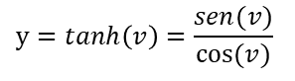



Função de ativação
Logística
Tangente hiperbólica
ReLu
PReLu
1
1
1
1
0.5
0.5
0.5
0.5
0
0
0
0
-0.5
-0.5
-0.5
-0.5
-1
-1
-1
-1
$$y=\frac{1}{1+e^{−v}}$$
$$y=tanh\left(v\right)=\frac{sen(v)}{cos⁡(v)}$$
$$y=max⁡(0,v)$$
$$y=max⁡(av,v)$$
Se a=0,01 → Leak ReLu

Slide 37
Camada de pooling

Slide 38
Camada de pooling
0,2 | 0,5 | 0,7 | 0,4
0,4 | 0,1 | 0,3 | 0,6
0,4 | 0,1 | 0,7 | 0,5
0,3 | 0,2 | 0,5 | 0,9
H
D
W

Slide 39
Camada de pooling
0,2 | 0,5 | 0,7 | 0,4
0,4 | 0,1 | 0,3 | 0,6
0,4 | 0,1 | 0,7 | 0,5
0,3 | 0,2 | 0,5 | 0,9
H
Max-pooling
(2 x 2)
0,5 | 0,7
0,4 | 0,9
H/2
D
W/2
D
W

Slide 40
Camada de pooling
0,2 | 0,5 | 0,7 | 0,4
0,4 | 0,1 | 0,3 | 0,6
0,4 | 0,1 | 0,7 | 0,5
0,3 | 0,2 | 0,5 | 0,9
H
Max-pooling
(2 x 2)
0,5 | 0,7
0,4 | 0,9
H/2
D
W/2
D
W
0,2 | 0,5 | 0,7 | 0,4
0,4 | 0,1 | 0,3 | 0,6
0,4 | 0,1 | 0,7 | 0,5
0,3 | 0,2 | 0,5 | 0,9
H
D
W

Slide 41
Camada de pooling
0,2 | 0,5 | 0,7 | 0,4
0,4 | 0,1 | 0,3 | 0,6
0,4 | 0,1 | 0,7 | 0,5
0,3 | 0,2 | 0,5 | 0,9
H
Max-pooling
(2 x 2)
0,5 | 0,7
0,4 | 0,9
H/2
D
W/2
D
W
0,2 | 0,5 | 0,7 | 0,4
0,4 | 0,1 | 0,3 | 0,6
0,4 | 0,1 | 0,7 | 0,5
0,3 | 0,2 | 0,5 | 0,9
H
Average-pooling
(2 x 2)
0,2 | 0,5
0,4 | 0,1
H/2
D
W/2
D
W

Slide 42
Camada completamente conectada

Slide 43
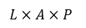

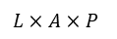
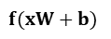


Camada completamente conectada
$$x$$
$$W$$
$$f(xW+b)$$
...
$$…$$
$$L×A×P$$
$$L×A×P$$

Slide 44
Camada de saída - softmax

Slide 45
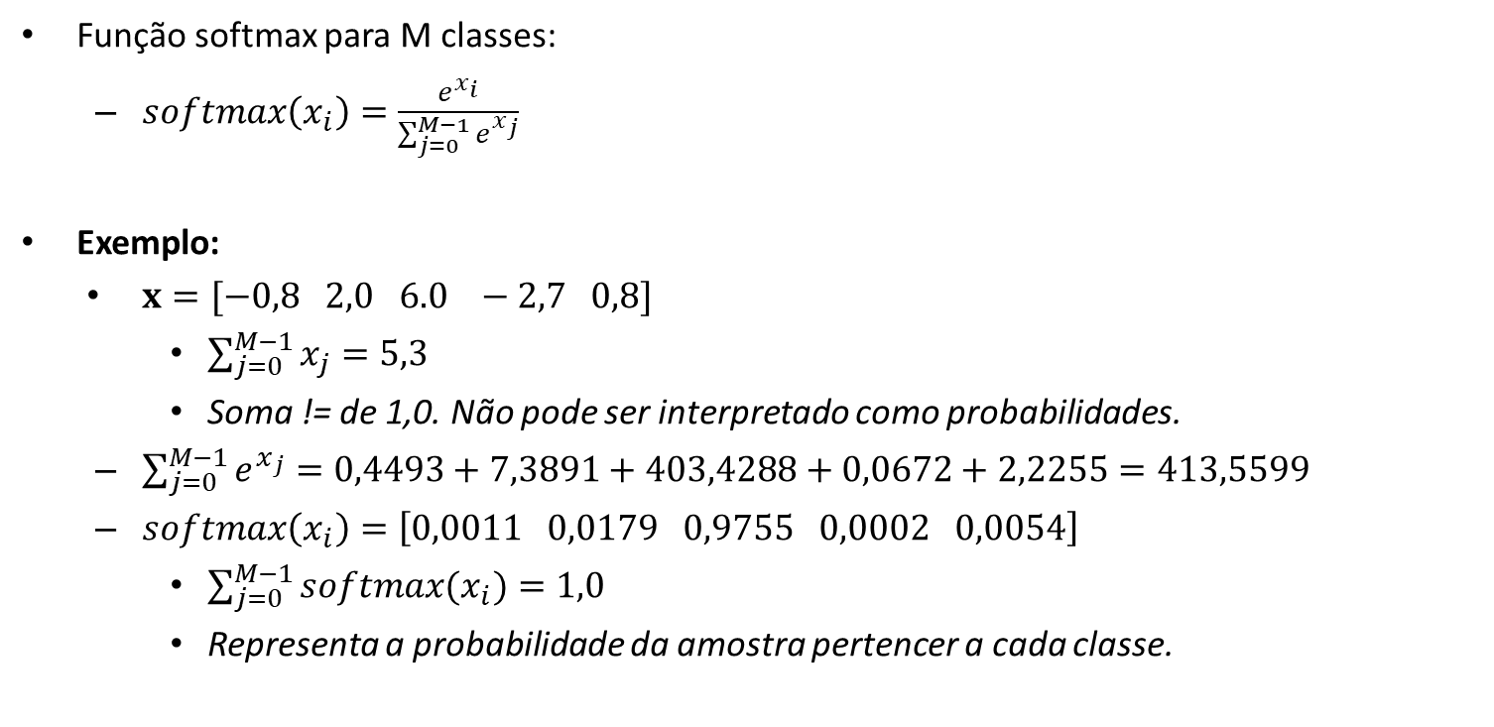
Camada de saída – softmax
Função softmax para M classes:
$softmax\left(x_{i}\right)=\frac{e^{x_{i}}}{\sum_{j=0}^{M−1}{e^{x_{j}}}}$
Exemplo:
$x=[−0,8 2,0 6.0 −2,7 0,8]$
$\sum_{j=0}^{M−1}{x_{j}}=5,3$
Soma != de 1,0. Não pode ser interpretado como probabilidades.
$\sum_{j=0}^{M−1}{e^{x_{j}}}=0,4493+7,3891+403,4288+0,0672+2,2255=413,5599$
$softmax\left(x_{i}\right)=\left[0,0011 0,0179 0,9755 0,0002 0,0054\right]$
$\sum_{j=0}^{M−1}{softmax(x_{i})}=1,0$
Representa a probabilidade da amostra pertencer a cada classe.

Slide 46
Função de perda (loss)

Slide 47
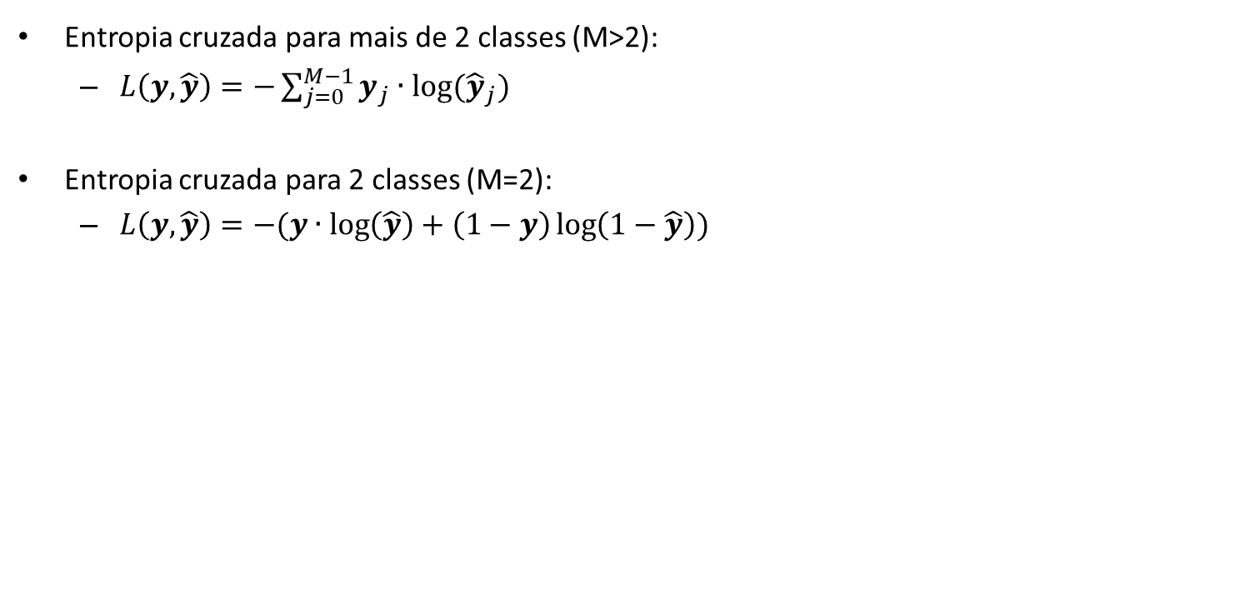
Função de perda (loss)
Entropia cruzada para mais de 2 classes (M>2):
$L\left(y, \hat{y}\right)=−\sum_{j=0}^{M−1}{y_{j}∙log⁡({\hat{y}}_{j})}$
Entropia cruzada para 2 classes (M=2):
$L\left(y, \hat{y}\right)=−(y∙\log\left(\hat{y}\right)+\left(1−y\right)\log\left(1−\hat{y}\right))$

Slide 48
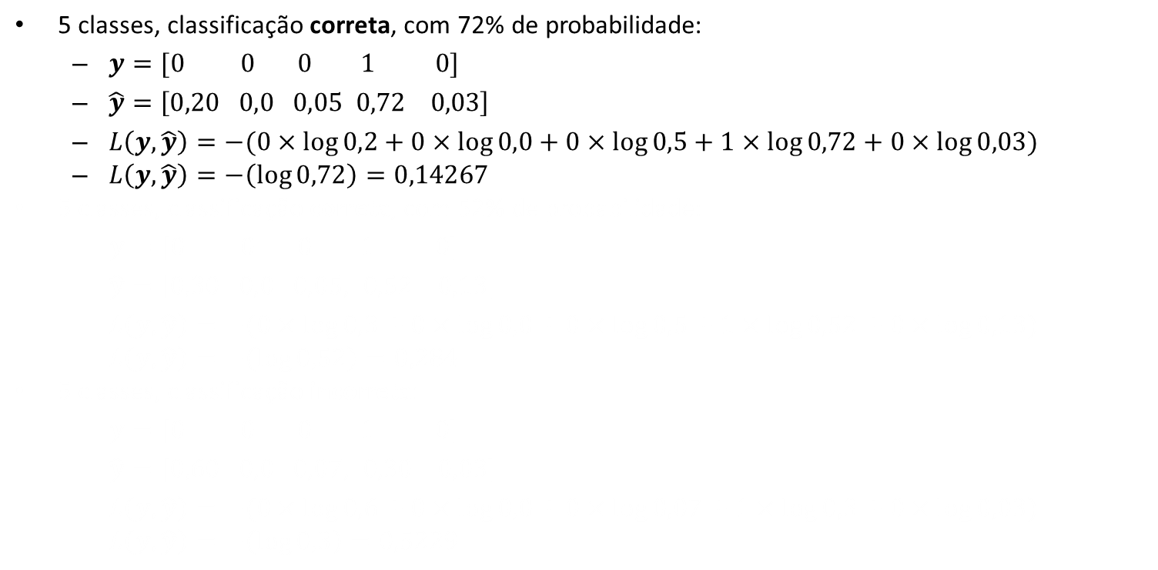
Entropia cruzada para M>2
5 classes, classificação correta, com 72% de probabilidade:
$y=[0 0 0 1 0]$
$\hat{y}=\left[0,20 0,0 0,05 0,72 0,03\right]$
$L\left(y, \hat{y}\right)=−(0×\log{0,2}+0×\log{0,0}+0×\log{0,5}+1×\log{0,72}+0×\log{0,03})$
$L\left(y, \hat{y}\right)=−\left(\log{0,72}\right)=0,14267$
5 classes, classificação correta, com 52% de probabilidade:
$y=[0 0 0 1 0]$
$\hat{y}=\left[0,30 0,0 0,05, 0,52 0,13\right]$
$L\left(y, \hat{y}\right)=−(0×\log{0,3}+0×\log{0,0}+0×\log{0,5}+1×\log{0,52}+0×\log{0,13})$
$L\left(y, \hat{y}\right)=−\left(\log{0,52}\right)=0,284$
5 classes, classificação incorreta:
$y=[0 0 0 1 0]$
$\hat{y}=\left[0,60 0,0 0,07, 0,30 0,03\right]$
$L\left(y, \hat{y}\right)=−(0×\log{0,6}+0×\log{0,0}+0×\log{0,07}+1×\log{0,3}+0×\log{0,03})$
$L\left(y, \hat{y}\right)=−\left(\log{0,3}\right)=0,5229$

Slide 49
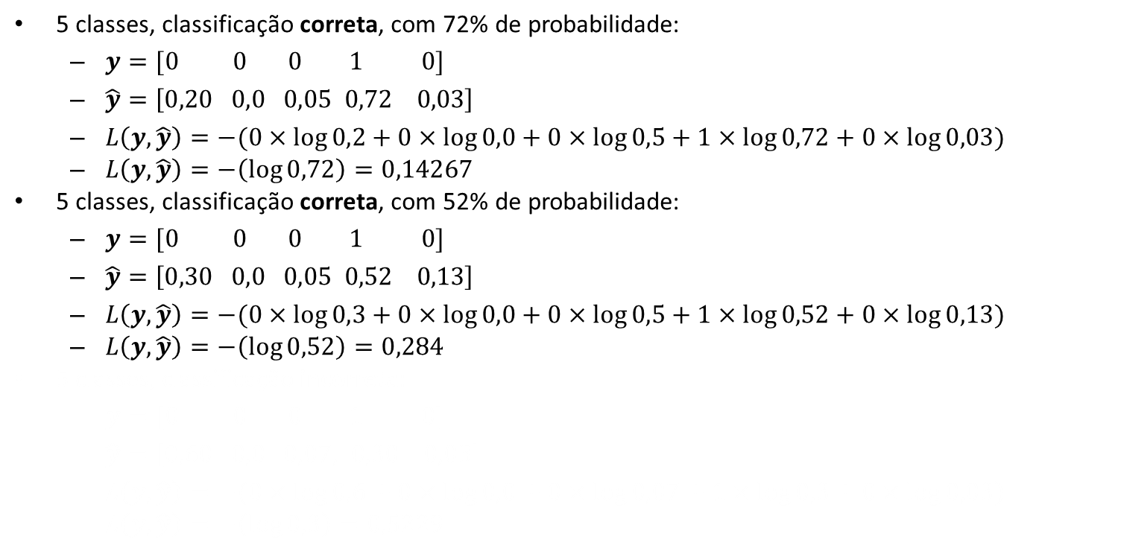
Entropia cruzada para M>2
5 classes, classificação correta, com 72% de probabilidade:
$y=[0 0 0 1 0]$
$\hat{y}=\left[0,20 0,0 0,05 0,72 0,03\right]$
$L\left(y, \hat{y}\right)=−(0×\log{0,2}+0×\log{0,0}+0×\log{0,5}+1×\log{0,72}+0×\log{0,03})$
$L\left(y, \hat{y}\right)=−\left(\log{0,72}\right)=0,14267$
5 classes, classificação correta, com 52% de probabilidade:
$y=[0 0 0 1 0]$
$\hat{y}=\left[0,30 0,0 0,05 0,52 0,13\right]$
$L\left(y, \hat{y}\right)=−(0×\log{0,3}+0×\log{0,0}+0×\log{0,5}+1×\log{0,52}+0×\log{0,13})$
$L\left(y, \hat{y}\right)=−\left(\log{0,52}\right)=0,284$
5 classes, classificação incorreta:
$y=[0 0 0 1 0]$
$\hat{y}=\left[0,60 0,0 0,07, 0,30 0,03\right]$
$L\left(y, \hat{y}\right)=−(0×\log{0,6}+0×\log{0,0}+0×\log{0,07}+1×\log{0,3}+0×\log{0,03})$
$L\left(y, \hat{y}\right)=−\left(\log{0,3}\right)=0,5229$

Slide 50
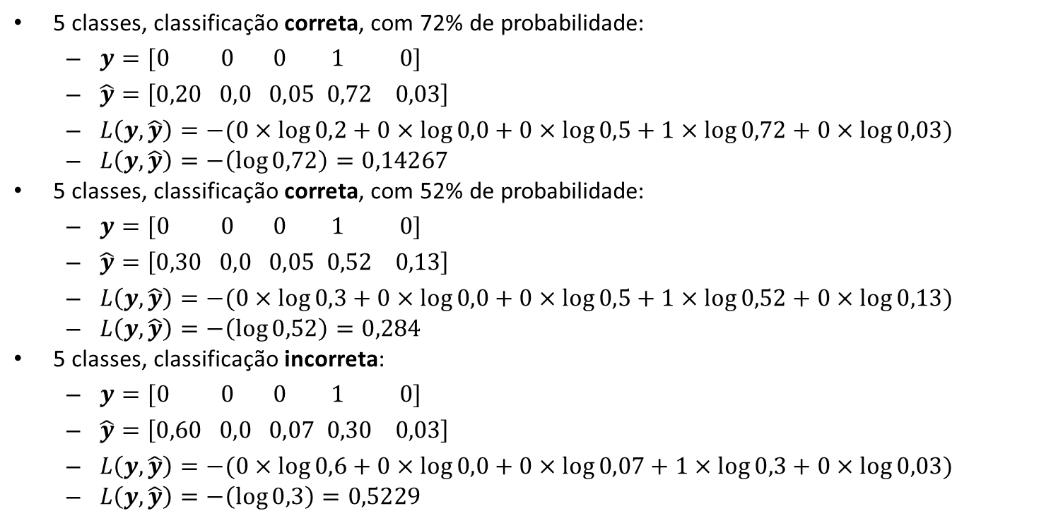
Entropia cruzada para M>2
5 classes, classificação correta, com 72% de probabilidade:
$y=[0 0 0 1 0]$
$\hat{y}=\left[0,20 0,0 0,05 0,72 0,03\right]$
$L\left(y, \hat{y}\right)=−(0×\log{0,2}+0×\log{0,0}+0×\log{0,5}+1×\log{0,72}+0×\log{0,03})$
$L\left(y, \hat{y}\right)=−\left(\log{0,72}\right)=0,14267$
5 classes, classificação correta, com 52% de probabilidade:
$y=[0 0 0 1 0]$
$\hat{y}=\left[0,30 0,0 0,05 0,52 0,13\right]$
$L\left(y, \hat{y}\right)=−(0×\log{0,3}+0×\log{0,0}+0×\log{0,5}+1×\log{0,52}+0×\log{0,13})$
$L\left(y, \hat{y}\right)=−\left(\log{0,52}\right)=0,284$
5 classes, classificação incorreta:
$y=[0 0 0 1 0]$
$\hat{y}=\left[0,60 0,0 0,07 0,30 0,03\right]$
$L\left(y, \hat{y}\right)=−(0×\log{0,6}+0×\log{0,0}+0×\log{0,07}+1×\log{0,3}+0×\log{0,03})$
$L\left(y, \hat{y}\right)=−\left(\log{0,3}\right)=0,5229$

Slide 51
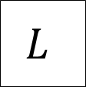
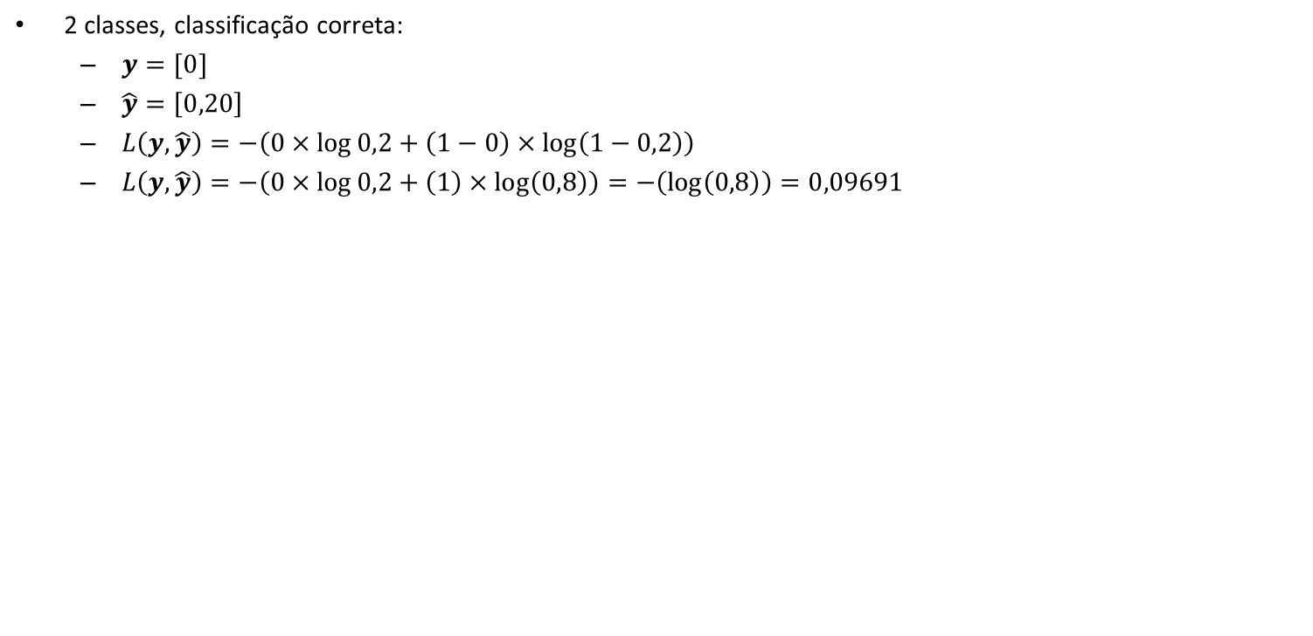
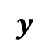
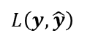
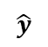
Entropia cruzada para M=2
2 classes, classificação correta:
$y=[0]$
$\hat{y}=\left[0,20\right]$
$L\left(y, \hat{y}\right)=−\left(0×\log{0,2}+\left(1−0\right)×\log\left(1−0,2\right)\right)$
$L\left(y, \hat{y}\right)=−\left(0×\log{0,2}+\left(1\right)×\log\left(0,8\right)\right)=−\left(\log\left(0,8\right)\right)=0,09691$
2 classes, classificação correta:
$y=[1]$
$\hat{y}=\left[0,92\right]$
$L\left(y, \hat{y}\right)=−\left(1×\log{0,92}+\left(1−1\right)×\log\left(1−0,92\right)\right)$
$L\left(y, \hat{y}\right)=−\left(1×\log{0,92}+\left(0\right)×\log\left(0,08\right)\right)=−\left(\log\left(0,92\right)\right)=0,03621$
2 classes, classificação incorreta:
$y=[0]$
$\hat{y}=\left[0,65\right]$
$L\left(y, \hat{y}\right)=−\left(0×\log{0,65}+\left(1−0\right)×\log\left(1−0,65\right)\right)$
$L\left(y, \hat{y}\right)=−\left(0×\log{0,65}+\left(1\right)×\log\left(0,35\right)\right)=−\left(\log\left(0,35\right)\right)=0,45593$
1,0
θ = 0,5
–1,0
Logística
$$\hat{y}$$
$$L$$
$$L\left(y, \hat{y}\right)$$
...
$$y$$

Slide 52
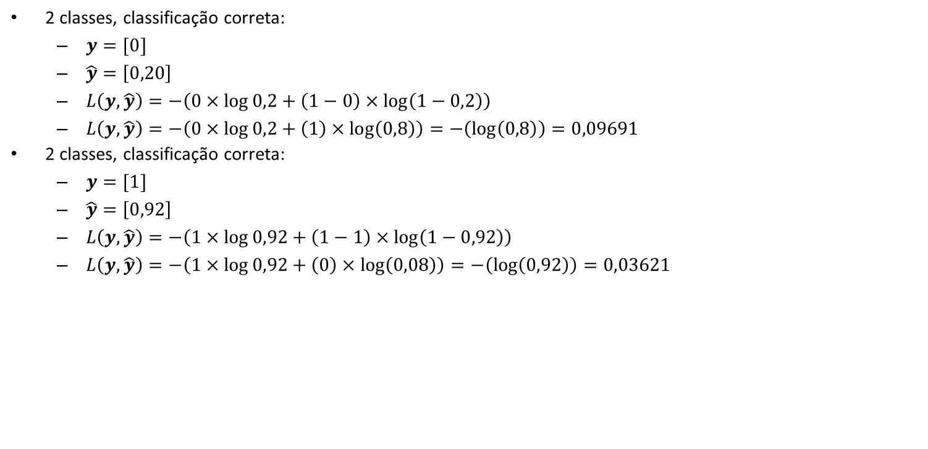
Entropia cruzada para M=2
2 classes, classificação correta:
$y=[0]$
$\hat{y}=\left[0,20\right]$
$L\left(y, \hat{y}\right)=−\left(0×\log{0,2}+\left(1−0\right)×\log\left(1−0,2\right)\right)$
$L\left(y, \hat{y}\right)=−\left(0×\log{0,2}+\left(1\right)×\log\left(0,8\right)\right)=−\left(\log\left(0,8\right)\right)=0,09691$
2 classes, classificação correta:
$y=[1]$
$\hat{y}=\left[0,92\right]$
$L\left(y, \hat{y}\right)=−\left(1×\log{0,92}+\left(1−1\right)×\log\left(1−0,92\right)\right)$
$L\left(y, \hat{y}\right)=−\left(1×\log{0,92}+\left(0\right)×\log\left(0,08\right)\right)=−\left(\log\left(0,92\right)\right)=0,03621$
2 classes, classificação incorreta:
$y=[0]$
$\hat{y}=\left[0,65\right]$
$L\left(y, \hat{y}\right)=−\left(0×\log{0,65}+\left(1−0\right)×\log\left(1−0,65\right)\right)$
$L\left(y, \hat{y}\right)=−\left(0×\log{0,65}+\left(1\right)×\log\left(0,35\right)\right)=−\left(\log\left(0,35\right)\right)=0,45593$
1,0
θ = 0,5
–1,0
Logística
$$\hat{y}$$
$$L$$
$$L\left(y, \hat{y}\right)$$
...
$$y$$

Slide 53
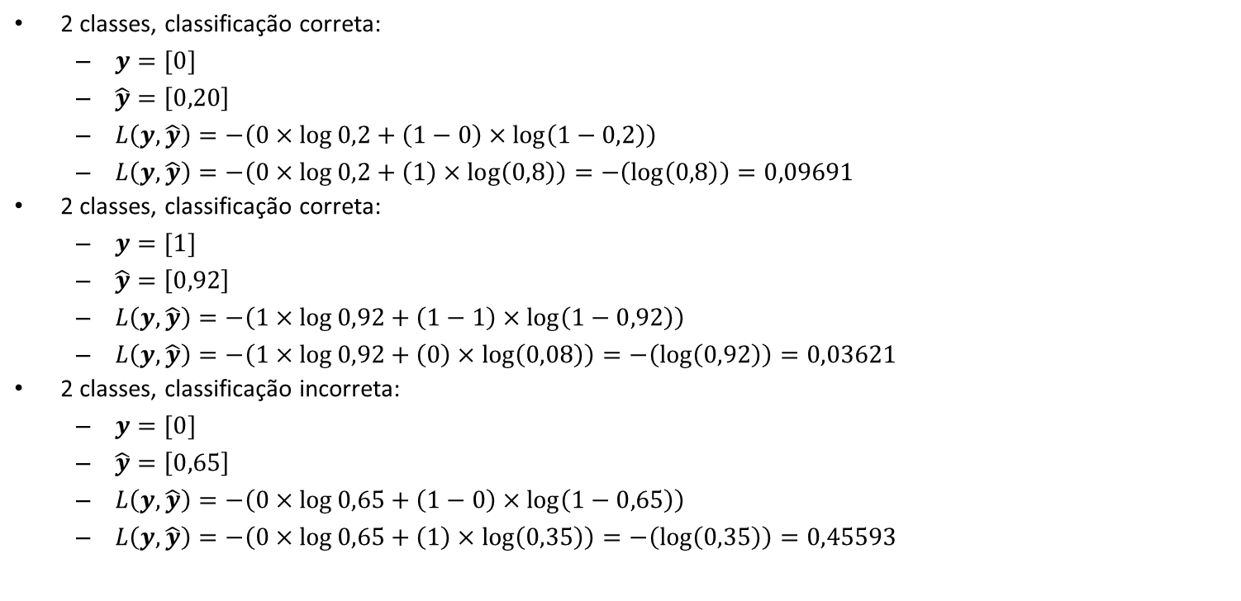
Entropia cruzada para M=2
2 classes, classificação correta:
$y=[0]$
$\hat{y}=\left[0,20\right]$
$L\left(y, \hat{y}\right)=−\left(0×\log{0,2}+\left(1−0\right)×\log\left(1−0,2\right)\right)$
$L\left(y, \hat{y}\right)=−\left(0×\log{0,2}+\left(1\right)×\log\left(0,8\right)\right)=−\left(\log\left(0,8\right)\right)=0,09691$
2 classes, classificação correta:
$y=[1]$
$\hat{y}=\left[0,92\right]$
$L\left(y, \hat{y}\right)=−\left(1×\log{0,92}+\left(1−1\right)×\log\left(1−0,92\right)\right)$
$L\left(y, \hat{y}\right)=−\left(1×\log{0,92}+\left(0\right)×\log\left(0,08\right)\right)=−\left(\log\left(0,92\right)\right)=0,03621$
2 classes, classificação incorreta:
$y=[0]$
$\hat{y}=\left[0,65\right]$
$L\left(y, \hat{y}\right)=−\left(0×\log{0,65}+\left(1−0\right)×\log\left(1−0,65\right)\right)$
$L\left(y, \hat{y}\right)=−\left(0×\log{0,65}+\left(1\right)×\log\left(0,35\right)\right)=−\left(\log\left(0,35\right)\right)=0,45593$
1,0
θ = 0,5
–1,0
Logística
$$\hat{y}$$
$$L$$
$$L\left(y, \hat{y}\right)$$
...
$$y$$

Slide 54
Otimizadores

Slide 55
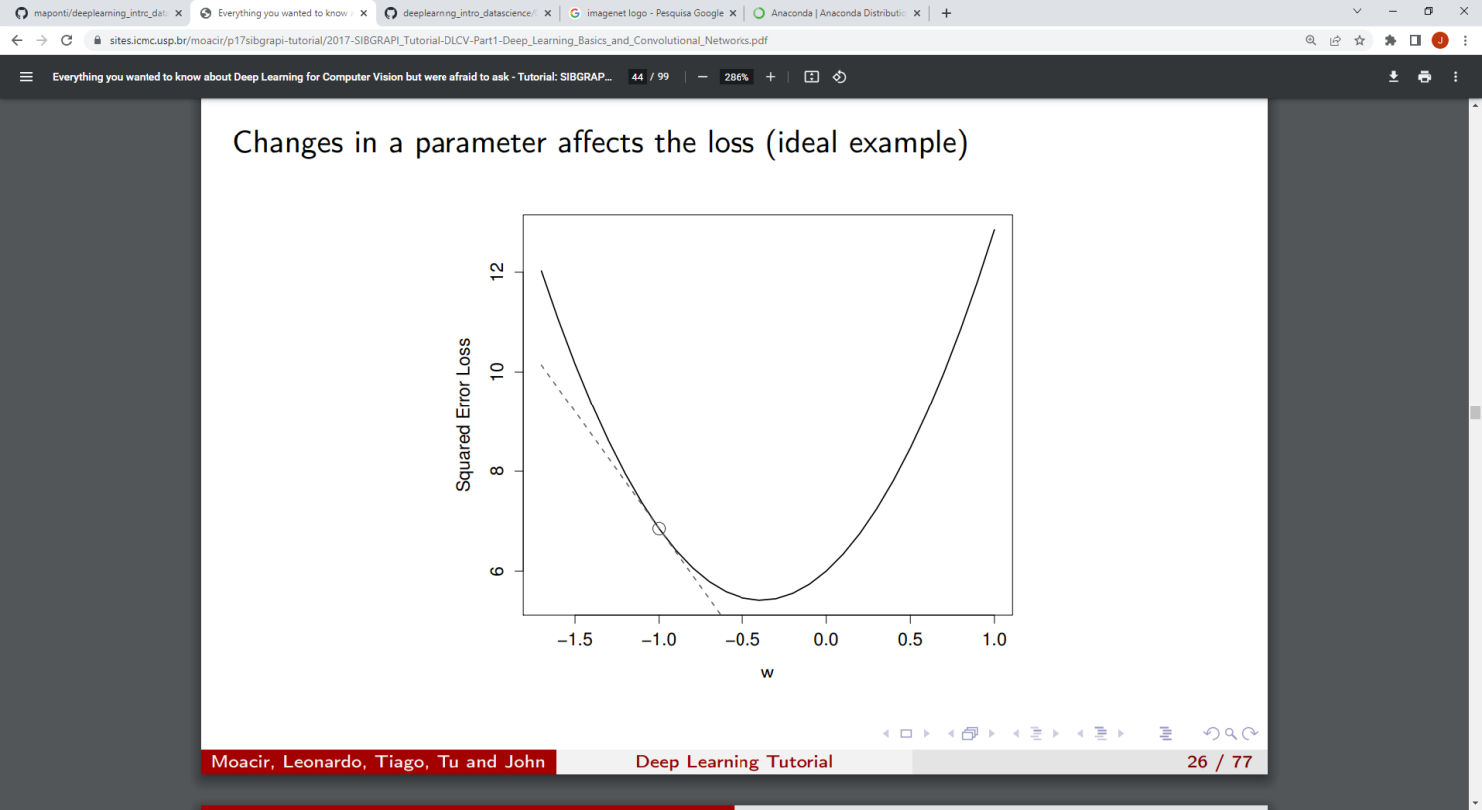
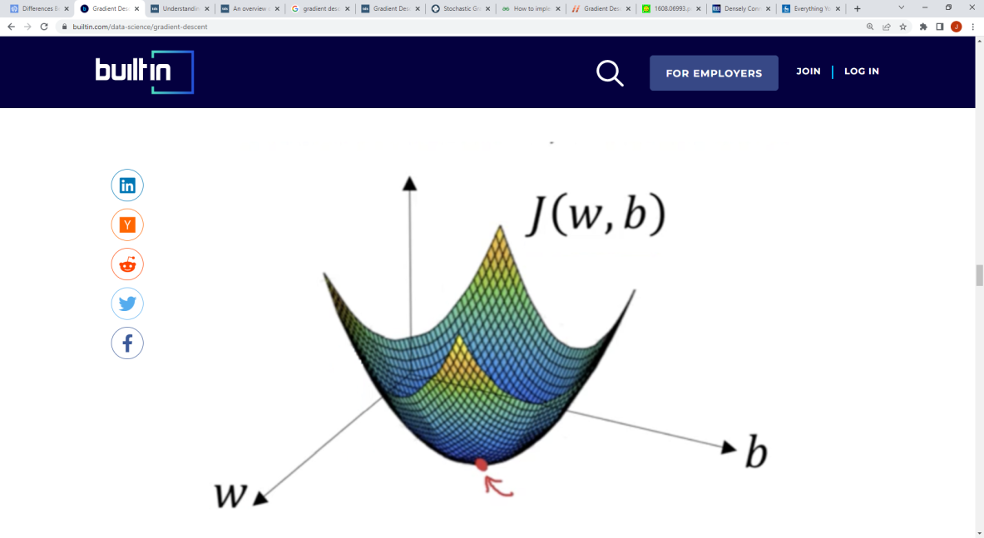
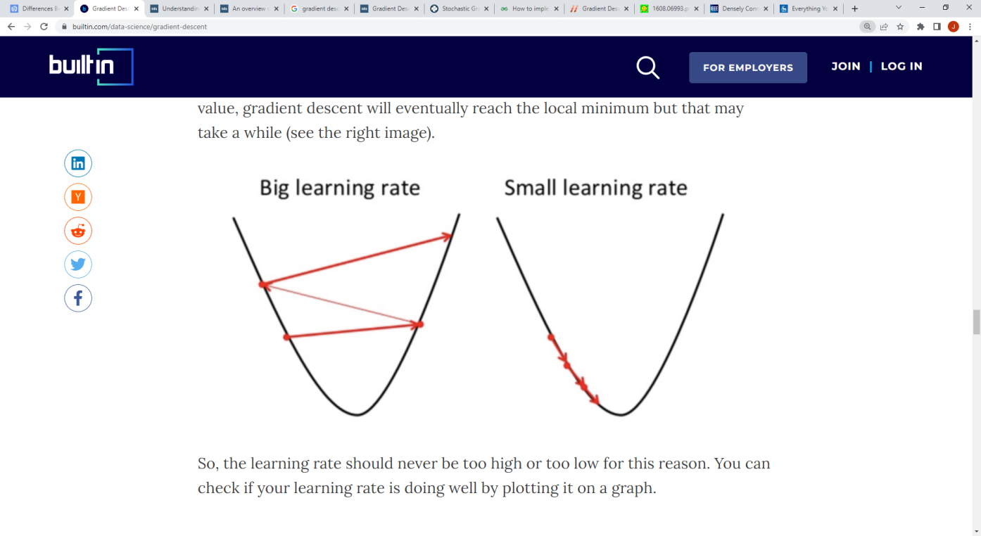
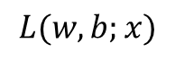
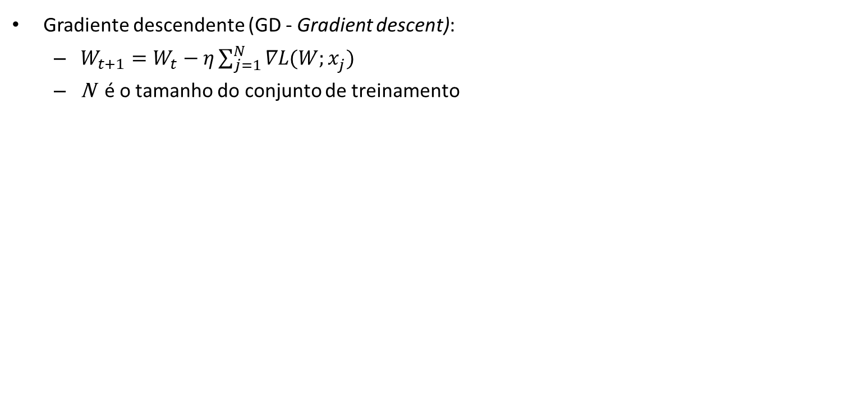
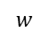
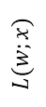
Otimizadores
Gradiente descendente (GD - Gradient descent):
$W_{t+1}=W_{t}−η\sum_{j=1}^{N}{∇L(W;x_{j}^{})}$
N é o tamanho do conjunto de treinamento
$$L(w,b;x)$$
$$L(w;x)$$
$$w$$
Donges. Gradient Descent in Machine Learning: A Basic Introduction. https://builtin.com/data-science/gradient-descent
Moacir Ponti. http://conteudo.icmc.usp.br/pessoas/moacir/p17sibgrapi-tutorial/

Slide 56
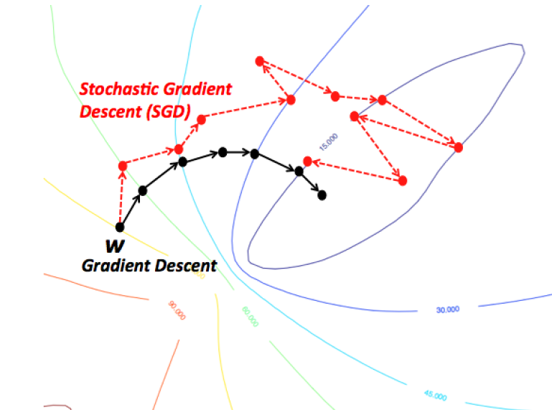
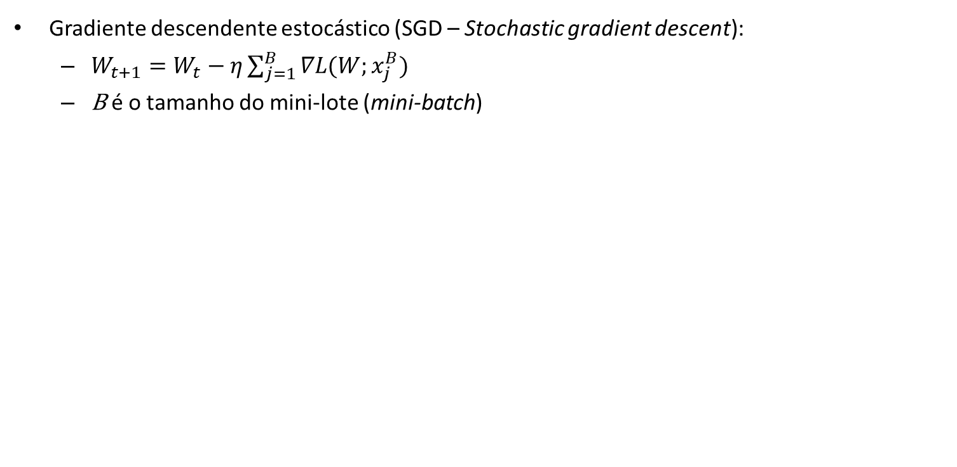
Otimizadores
Gradiente descendente estocástico (SGD – Stochastic gradient descent):
$W_{t+1}=W_{t}−η\sum_{j=1}^{B}{∇L(W;x_{j}^{B})}$
B é o tamanho do mini-lote (mini-batch)
https://wikidocs.net/3413

Slide 57
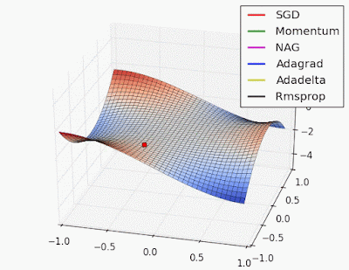
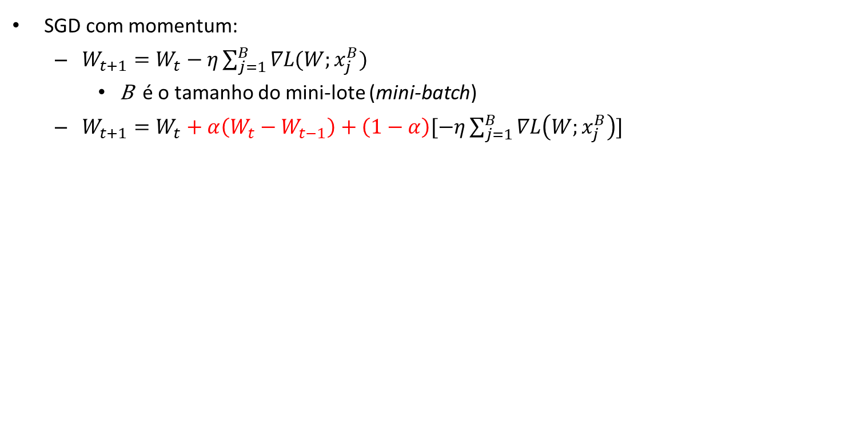
Otimizadores
SGD com momentum:
$W_{t+1}=W_{t}−η\sum_{j=1}^{B}{∇L(W;x_{j}^{B})}$
B é o tamanho do mini-lote (mini-batch)
$W_{t+1}=W_{t}+α\left(W_{t}−W_{t−1}\right)+\left(1−α\right)[−η\sum_{j=1}^{B}{∇L\left(W;x_{j}^{B}\right)}]$
http://www.denizyuret.com/2015/03/alec-radfords-animations-for.html

Slide 58
Otimizadores
Outros otimizadores:
AdaGrad - Adaptive Gradient
AdaDelta - Adaptive learning rate
RMSProp - Root Mean Squared Propagation
Adam - Adaptive moment estimation
...

Slide 59
Arquiteturas

Slide 60
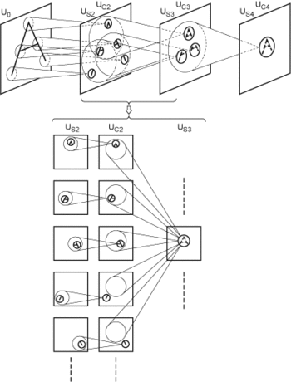

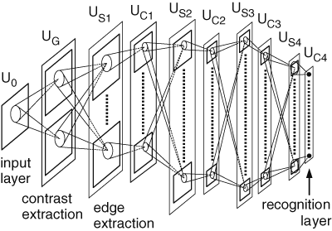
Arquiteturas
Neocognitron (1979)
Kunihiko Fukushima
Fukushima, K. (1980). "Neocognitron: A self-organizing neural network model for a mechanism of pattern recognition unaffected by shift in position". Biological Cybernetics. 36 (4)

Slide 61

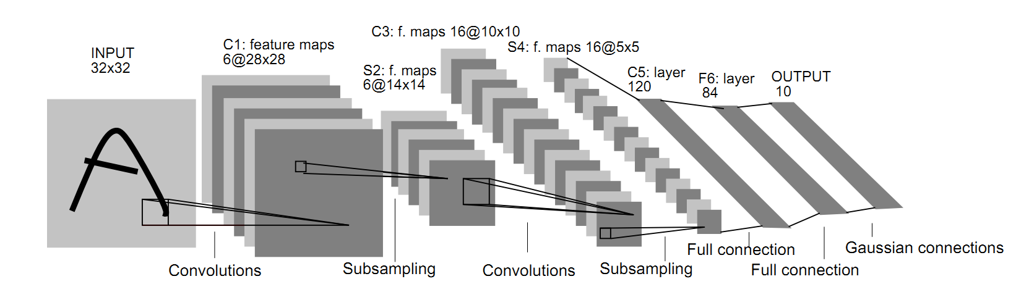
Arquiteturas
LeNet-5 (1998)
Yann LeCun
Lecun, Y. et al. (1998). "Gradient-based learning applied to document recognition". Proceedings of the IEEE. 86 (11): 2278–2324.

Slide 62

Arquiteturas
AlexNet (2012)
Krizhevsky, Sutskever e Hinton. ImageNet Classification with Deep Convolutional Neural Networks. NeuripIPS 2012

Slide 63
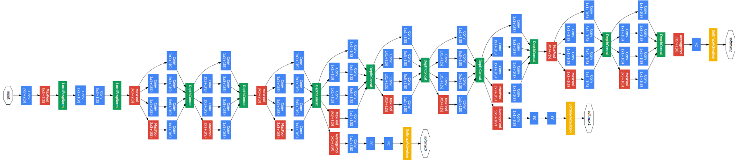
Arquiteturas
Inception (GoogLeNet) (2015)
Szegedy, Christian (2015). "Going deeper with convolutions". CVPR2015.

Slide 64

Arquiteturas
VGG (2014) e ResNet (2015)
Simonyan e Zisserman. Very Deep Convolutional Networks for Large-Scale Image Recognition. 2014
He et al. Deep Residual Learning for Image Recognition. 2015.

Slide 65


Arquiteturas
DenseNet (2017)
Huang et al. Densely Connected Convolutional Networks. CVPR 2017.
Ponti et al. Everything You Wanted to Know about Deep Learning for Computer Vision but Were Afraid to Ask. Sibgrapi 2017.

Slide 66

Arquiteturas
ImageNet Large Scale Visual Recognition Challenge
https://image-net.org/challenges/LSVRC/
https://semiengineering.com/new-vision-technologies-for-real-world-applications/

Slide 67
Bibliotecas e desenvolvimento

Slide 68


Bibliotecas e desenvolvimento
O treinamento de CNNs possui alto custo computacional.
Recomenda-se que sejam treinados usando GPUs.
O Google Colab fornece acesso à GPUs (com algumas restrições).

Slide 69


Bibliotecas e desenvolvimento
Principais bibliotecas para Deep Learning e Redes Neurais Convolucionais
PyTorch
https://pytorch.org/
Tensorflow
https://www.tensorflow.org/

Slide 70


Bibliotecas e desenvolvimento
Anaconda Distribution:
Distribuição Python com suporte às principais bibliotecas
https://www.anaconda.com/products/distribution
Google Colab:
Ambiente de execução em nuvem com GPUs.
https://colab.research.google.com

Slide 71
Conjuntos de imagens

Slide 72

Conjuntos de imagens
MNIST
http://yann.lecun.com/exdb/mnist/
60,000 training images
10,000 testing images
28 x 28 pixels
Níveis de cinza

Slide 73

Conjuntos de imagens
Cats vs. Dogs:
https://www.kaggle.com/c/dogs-vs-cats
25,000 images de treinamento
12,500 imagens de teste
2 classes
Diversos tamanhos
RGB

Slide 74

Conjuntos de imagens
CIFAR10:
https://www.cs.toronto.edu/~kriz/cifar.html
50,000 training images
10,000 testing images
10 classes
32 x 32 pixels
RGB

Slide 75

Conjuntos de imagens
ImageNet:
https://www.image-net.org/
~1,000,000 imagens
1,000 classes
RGB

Slide 76
Bibliografia
Ponti et al. Everything You Wanted to Know about Deep Learning for Computer Vision but Were Afraid to Ask. Sibgrapi 2017.
Moacir Ponti (ICMC-USP). Material para o minicurso Deep Learning
https://github.com/maponti/deeplearning_intro_datascience
Learn TensorFlow and deep learning, without a Ph.D.
https://cloud.google.com/blog/products/gcp/learn-tensorflow-and-deep-learning-without-a-phd
CS231n: Convolutional Neural Networks for Visual Recognition
http://cs231n.github.io/
Goodfellow, Bengio e Courville. Deep Learning. MIT Press, 2016
https://www.deeplearningbook.org/
The MathWorks, Inc. What is a Convolutional Neural Network? 3 things you need to know.
https://www.mathworks.com/discovery/convolutional-neural-network-matlab.html

Slide 77
Bibliografia
Fukushima, K. (1980). Neocognitron: A self-organizing neural network model for a mechanism of pattern recognition unaffected by shift in position. Biological Cybernetics. 36 (4): 193–202.
10.1007/bf00344251
Lecun, Y. et al. (1998). Gradient-based learning applied to document recognition. Proceedings of the IEEE. 86 (11): 2278–2324.
10.1109/5.726791
Krizhevsky, Sutskever e Hinton. ImageNet Classification with Deep Convolutional Neural Networks. NeuripIPS 2012.
Szegedy, Christian (2015). Going deeper with convolutions. CVPR2015.
Simonyan e Zisserman. Very Deep Convolutional Networks for Large-Scale Image Recognition. 2014.
He et al. Deep Residual Learning for Image Recognition. 2015.
Huang et al. Densely Connected Convolutional Networks. CVPR 2017.

Slide 78
Bibliografia
Rodrigues, L. F.; Naldi M. C., Mari, J. F. Comparing convolutional neural networks and preprocessing techniques for HEp-2 cell classification in immunofluorescence images. Computers in Biology and Medicine, 2019.
https://doi.org/10.1016/j.compbiomed.2019.103542

Slide 79
FIM

